Slide 1
UTA 2030
Shared Dreams, Bright Future

Slide 2
UTA 2030 Strategic Plan
2022
2023
2024
2025
2026
2027
2028
2029
2030
Expected publication
Winter ’24
Planning Began January 2023
Strategic Plan – UTA 2030
ster Plan
Planning Began Fall 2023
Campus Master Plan
Planning Began Fall 2023
Strategic Enrollment Plan
2

Slide 3





Strategic Plan Timeline
As we chart our path forward, UTA is focusing on the dreams of our community centered on the 5 strategic theme areas, culminating in our UTA 2030 Shared Dreams, Bright Future strategic plan.
April 2022 - September 2022​
Fall 2022
January 2023​
Summer 2023​
August 2023
Fall 2023​
Winter 2023 -​ Spring 2024​
Academic and Business unit listening and engagement
sessions
5 strategic theme
areas identified
Leadership planning
retreat and institutional planning committee
formed
Committee work
begins, continuing
stakeholder
engagement
Retreat and status
update to leadership
Theme Work Groups
gathering to develop
strategies, goals, and
targets for strategic
plan
Strategic Plan
Finalized and Launched
Student Success
Research & Innovation
People & Culture
Finance & Infrastructure
Alumni & Community Engagement
3

Slide 4

People & Culture
Goal
Strategies
Integrate UTA values throughout the University to support the campus in creating an environment and culture of belonging and engagement.
We will create and enhance a climate that values meaningful collaboration, recognition, and belonging.
Foster a culture that attracts and retains top–tier talent and empowers our employees to contribute to their best efforts.
Accelerate talent acquisition processes and management strategies across the University.

Slide 5
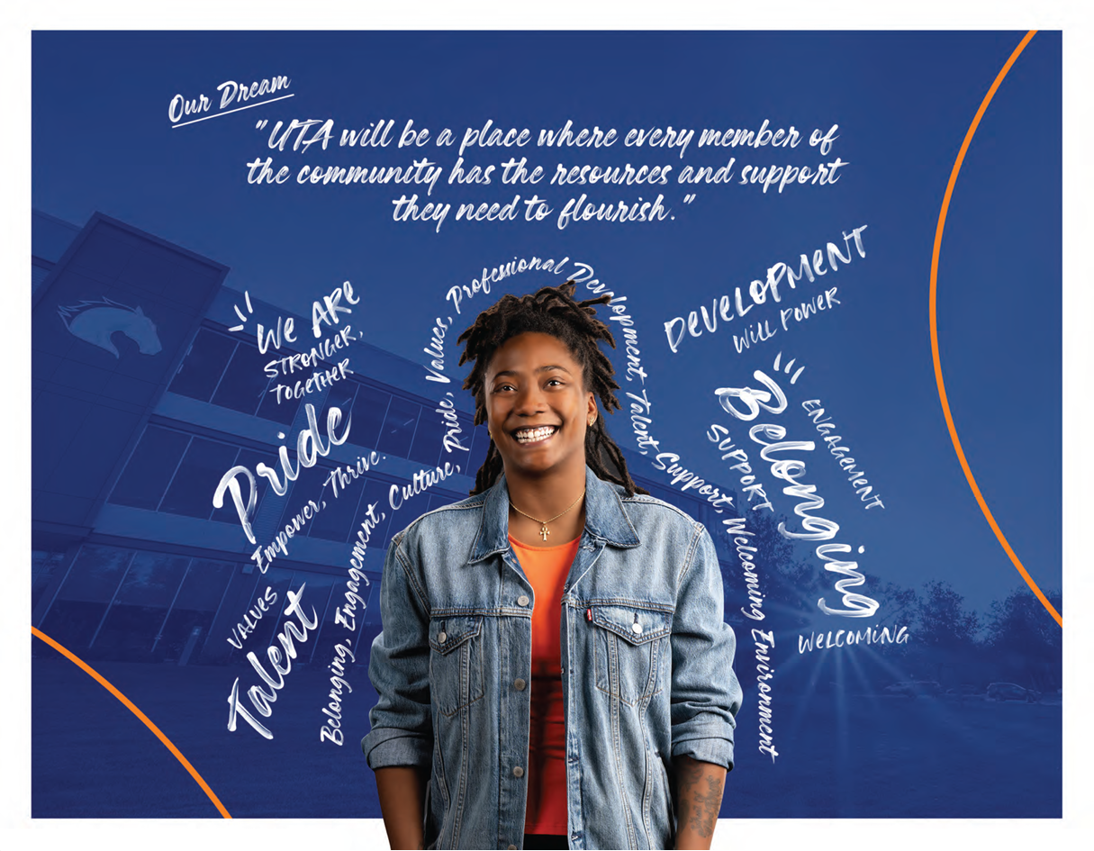
UTA 2030
People & Culture
Outcomes
Collaborative culture among faculty, staff, and students.
Motivated and highly developed employees.
Strengthened leadership and teamwork through belonging and engagement.
Enhanced internal processes, including communication and decision-making.

Slide 6
Student Success
Goal
Strategies
Enhance access and affordability for all students.
We will foster a vibrant learning community that empowers all students to succeed in their academic, personal, and professional goals
Elevate the educational journey to ensure a transformative student experience and timely graduation
Equip students with the skills, knowledge, and persistence to confidently and successfully
Foster a student–centered approach to well–being for all.

Slide 7
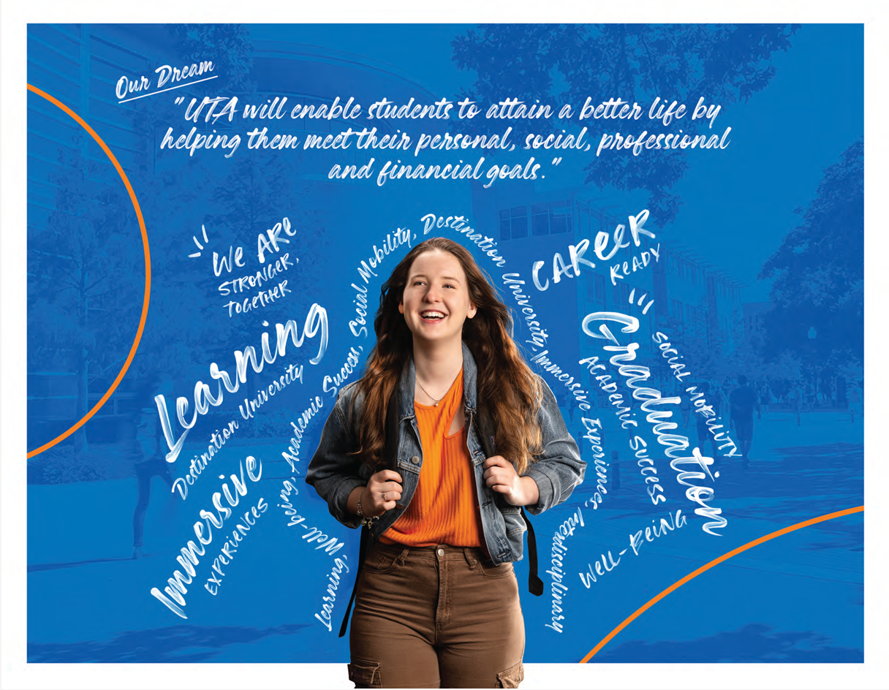
UTA 2030
Student Success
Outcomes
Achieved academic excellence and mastery of key concepts across disciplines.
Students equipped with knowledge, skills, and mindset to succeed in college and beyond.
Enhanced academic, personal, social, and emotional development.
Engaged students who positively impact the communities they live in.

Slide 8
Research & Innovation
Goal
Strategies
Drive innovation and growth through expanded support for partnerships, operations, and infrastructure across the University.
We will elevate UTA as an internationally recognized leader in research, scholarship, and innovation.
Strengthen UTA’s research portfolio, capacity, and impact to drive transformative innovation and scholarship
Expand and enhance training and learning opportunities to inspire the next generation of leaders in research.
Forge strategies partnership with industry to advance sustainable economic growth and prosperity.

Slide 9

UTA 2030
Research & Innovation
Outcomes
Increased visibility of interdisciplinary research, creative work, and scholarship.
Strategic partnerships and alliances to advance scholarship.
Improved research grant success rates.
Vibrant research and innovation ecosystem within the University.
Increased research expenditures.

Slide 10
Alumni & Community Engagement
Goal
Strategies
Create a culture of engagement with our faculty, staff, students, and alumni community to move the University forward and achieve its mission.
We will deepen engagement in our community and across Texas and the nation through partnerships.
Maximize UTA’s impact in the communities it serves through leadership and advocacy.
Promote the prosperity and achievement of our community through active advocacy, assistance, and collaborative partnerships.
Elevate UTA’s brand as a top – tier university through strategic marketing and branding

Slide 11

UTA 2030
Alumni & Community Engagement
Outcomes
Engaged and active alumni base.
Increased philanthropic commitments.
Strengthened brand awareness.
Coordinated efforts with our community.

Slide 12
Finance & Infrastructure
Goal
Strategies
Optimize our financial management systems, financial models, and resource utilization strategies to ensure UTA meets its financial obligations.
We will accelerate infrastructure development and optimize financial sustainability to support the University’s vision.
Advance enterprise capabilities by modernizing, streamlining, and strengthening UTA’s physical infrastructure to support the University’s mission and vision.
Strengthen operational efficiency of administrative technology and protect vital University assets.

Slide 13
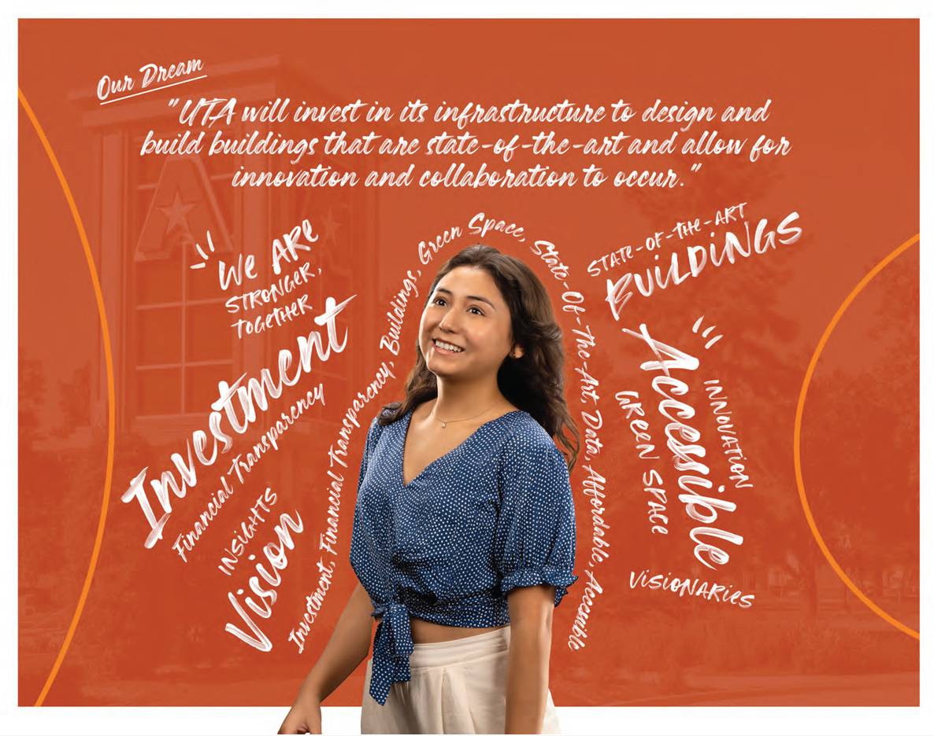
UTA 2030
Finance & Infrastructure
Outcomes
Disciplined financial stewardship.
Optimized use of technology.
Accessible resources needed to advance our mission.
Effective processes that promote operational and strategic agility.

Slide 14


