Slide 1

Campus Carry: The Basics
Concealed handguns on the UTA campus

Slide 2
Objectives
The purpose of this presentation is to give the campus community an overview of the University of Texas at Arlington’s “Campus Carry” policy: Handbook of Operating Procedures (HOP) 12-500.

Slide 3

Overview
As is the case with individuals possessing a driver’s license being expected to know the rules of the road in each state he or she drives through, such is the responsibility of the handgun license holder to understand the rules and regulations associated with his or her license to carry (LTC) in the state of Texas. The responsibility to know and comply with the law rests with the license holder.

Slide 4
Quick Facts
A LTC holder is not required to show his or her license unless directed by a law enforcement officer.
A LTC holder may carry his or her concealed firearm into a campus building unless it designated an “exclusionary area” by UTA policy or State or Federal law.
A LTC holder who chooses to carry is personally responsible for any injury or damage as a result of the use of their handgun.
Accidental or negligent discharge of a handgun by any employee or student may be cause for disciplinary action, up to and including termination (for employees) and expulsion (for students).
Individuals who violate the campus carry law are subject to criminal action.

Slide 5
What’s Covered
This presentation includes the following:
Definitions
Background and history of “Campus Carry”
Open Carry vs. Concealed Carry
Where a LTC holder may and may not carry on our campus
Specific Information for LTC Holders
Additional Resources and Videos
“Campus Carry” Policy: HOP 12-500

Slide 6
Common Definitions
Some common definitions are listed below. You can find a more complete list in HOP 12-500.
Word/Phrase | Definition
License to Carry (LTC) | Formerly called Concealed Handgun License (CHL). Generally, an applicant must meet 14 distinct standards to receive an LTC in Texas. Among them are requirements that the applicant be 1) a legal resident of Texas for six months prior to application; 2) at least 21 years of age; 3) not chemically dependent; and 4) capable of exercising sound judgment with respect to the proper use and storage of a handgun. For more information, please visit www.txdps.state.tx.us/rsd/chl/index.htm
Exclusionary Area | An area of campus, building, or room in which the possession of a handgun is prohibited as provided in Policy 12-500, Concealed Carry and Weapons on Campus.
Handgun | Any firearm designed, made, or adapted to be fired with one hand.
Holster | A holder made for firearms. Holsters must completely cover the entire trigger guard area and that can withstand any unexpected movement from jostling, falling, etc.

Slide 7
Background of Campus Carry
Texas Senate Bill 11, 84th Legislature (SB 11) is also called the “Campus Carry” law. It was signed into law on June 13, 2015, and took effect on August 1, 2016 for 4-year universities. It allows for the carrying of concealed handguns by LTC holders on all public university campuses including UTA.
Prior to this law, concealed handguns could be carried on campus grounds, but not in campus buildings.
Note: This law does not apply to commissioned peace officers, such as those with the University Police Department or City of Arlington Police.

Slide 8
SB 11 Allows Concealed Handguns to be
Carried on UTA’s Campus by LTC Holders
The law provides that the University must allow concealed handguns to be carried by a LTC holder on our campus. The president of each university may make reasonable rules regarding concealed carry on campus, including where handguns may not be carried, as long as it does not “generally prohibit or have the effect of generally prohibiting the carrying of a handgun by a LTC holder”.
Areas where handguns may not be carried address specific safety considerations and are referred to as “exclusionary areas.” These are outlined in the “Where You May and May Not Carry” section of this presentation.

Slide 9
Creating Rules Around Campus Carry
In even numbered years by September 1, UTA must submit a report to the legislature describing our policy provisions and the rationale for each of those policy provisions.
The UT System Board of Regents may amend or change any of UTA’s rules by a 2/3 majority vote.
Amending or modifying a campus’s policies and procedures is delegated to the president of the university.

Slide 10
Campus Carry Across the U.S.
In addition to Texas, other states such as Colorado, Idaho, Kansas, Mississippi, Oregon, Utah, and Wisconsin have “campus carry” laws. Some states have had this law in place for many years.

Slide 11
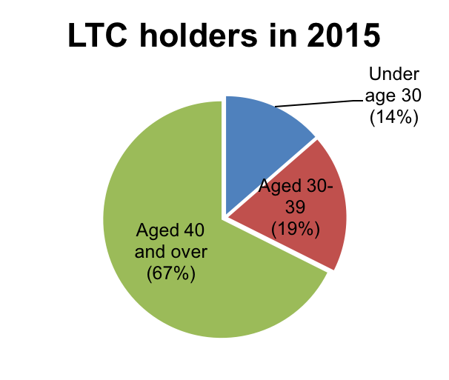
Demographics
Around 3-4% of the population of the State of Texas has a license to carry.
Most people who have a LTC are over the age of 40.
In 2015, 0.2459% of criminal convictions were committed by LTC Holders.
Source:
http://www.dps.texas.gov/RSD/CHL/Reports/2015Calendar/byAge/9LicenseApplicationsIssued.pdf http://www.dps.texas.gov/rsd/chl/reports/ActLicAndInstr/ActiveLicandInstr2015.pdf
https://www.txdps.state.tx.us/rsd/chl/reports/convrates.htm

Slide 12
UTA’s Commitment
UTA is committed to providing a safe and secure learning, working and living environment for our students, faculty, staff, and visitors and we must also respect the individual rights of those who are licensed to carry a concealed handgun.
We must comply with the law to the fullest extent possible without jeopardizing the free exchange of views and inclusive nature for which our campus is known.

Slide 13
Open Carry vs. Concealed Carry
Changes to two different laws happened during the same legislative session and are often confused. Here are some differences between the two laws:
Open Carry
Concealed Carry
The handgun can be carried in the “open”, such as in a holster outside of the clothing.
Prohibited for anyone on campus (excluding commissioned peace officers).
The handgun may not be noticeable by ordinary observation.
Allowed for anyone who has a LTC.

Slide 14
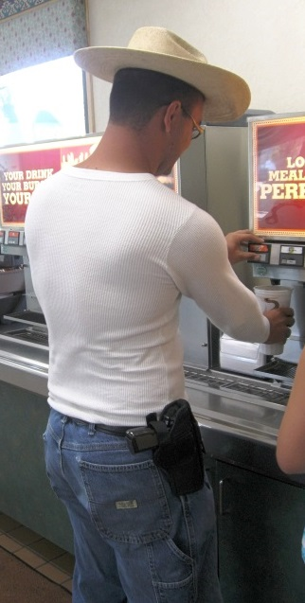
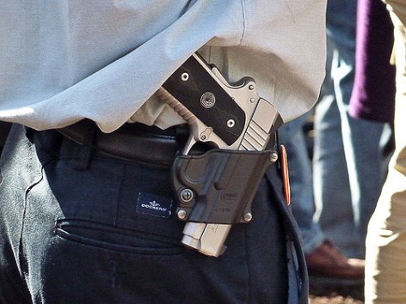


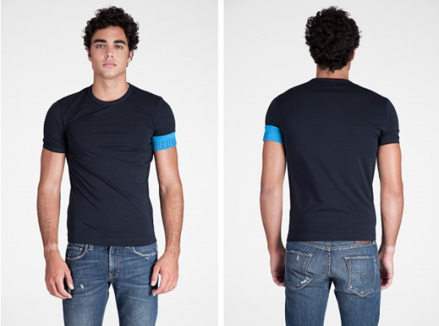
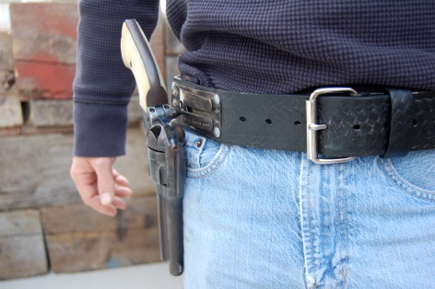
What Does Open Carry vs. Concealed Carry Look Like?
Open Carry - Visible
Concealed Carry - Not Visible
Photo by Michael Tefft
Not allowed on UT campuses
Starting August 1, 2016, allowed by LTC holders on UT campuses

Slide 15
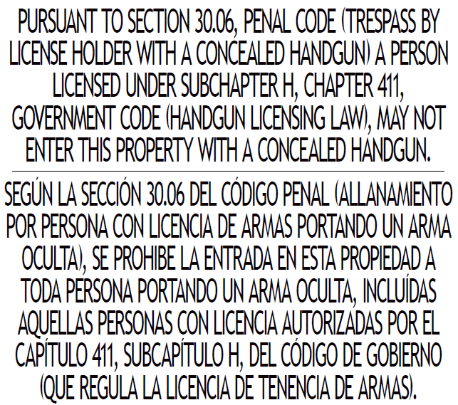
Open Carry vs. Concealed Carry Signage
Signs such as the one to the right are posted at locations where handguns are not allowed.
The license holder is responsible for knowing where a handgun may and may not be carried.
Example of a sign you may see around campus

Slide 16
Open Carry of Firearms on Campus
Because open carry is not allowed at UTA, if you see any type of firearm on campus:
Contact UTAPD immediately at (817) 272-3003 or policedepartment@uta.edu
Get a description of the person (race, gender, clothing/other unique attributes), what they were doing, their specific location, the direction they were headed, their vehicle, etc.
Do not confront the individual(s)
Avoid escalating the situation
REMEMBER, UTAPD CANNOT HELP IF THEY DON’T KNOW

Slide 17
Carrying on Campus
If you are a LTC Holder and choose to carry a concealed handgun on campus, you must:
Make sure the handgun is completely concealed (not visible) on campus premises, including buildings, streets, driveways, sidewalks, walkways, parking lots, garages, or other parking area.
And you must:
Carry it on or about your person at all times, or
Secure it in your locked, personal vehicle.

Slide 18
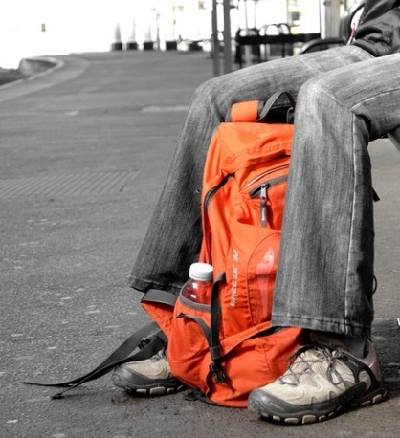
On or About Your Person
If you choose to carry a concealed handgun on campus it must be “on or about your person”; meaning the handgun must be close enough to you that you can grasp it without materially changing position.
For example, if you carry your handgun in a backpack, the backpack must always remain close to you, within immediate reach.
Note: There are no storage lockers on campus. If you need to enter an exclusion area, you must secure your handgun in your vehicle.

Slide 19
Where You May and May Not Carry
LTC holders are responsible for knowing where they can and cannot carry a handgun. There are specific places where carrying a handgun – concealed or visible – is prohibited by law, such as a:
Church, synagogue, or other established place of worship
Correctional facility
Courthouse or place where formal hearings are conducted
Amusement park
Patient-care areas, like a hospital or mental health facility
…and more at Texas Penal Code 46.03

Slide 20
University Exclusionary Areas
The University’s policies create “exclusionary areas” where the carrying of a concealed handgun is prohibited.
Our campus has a variety of facilities, meaning it’s not always easy to mark where exclusionary areas can or should be located. Sometimes only a portion of a building is excluded. Sometimes an area is only excluded for a small period of time while a particular activity takes place.
If you choose to carry a concealed handgun on campus, you must know where exclusionary areas are located. See campus map for exclusionary areas.

Slide 21
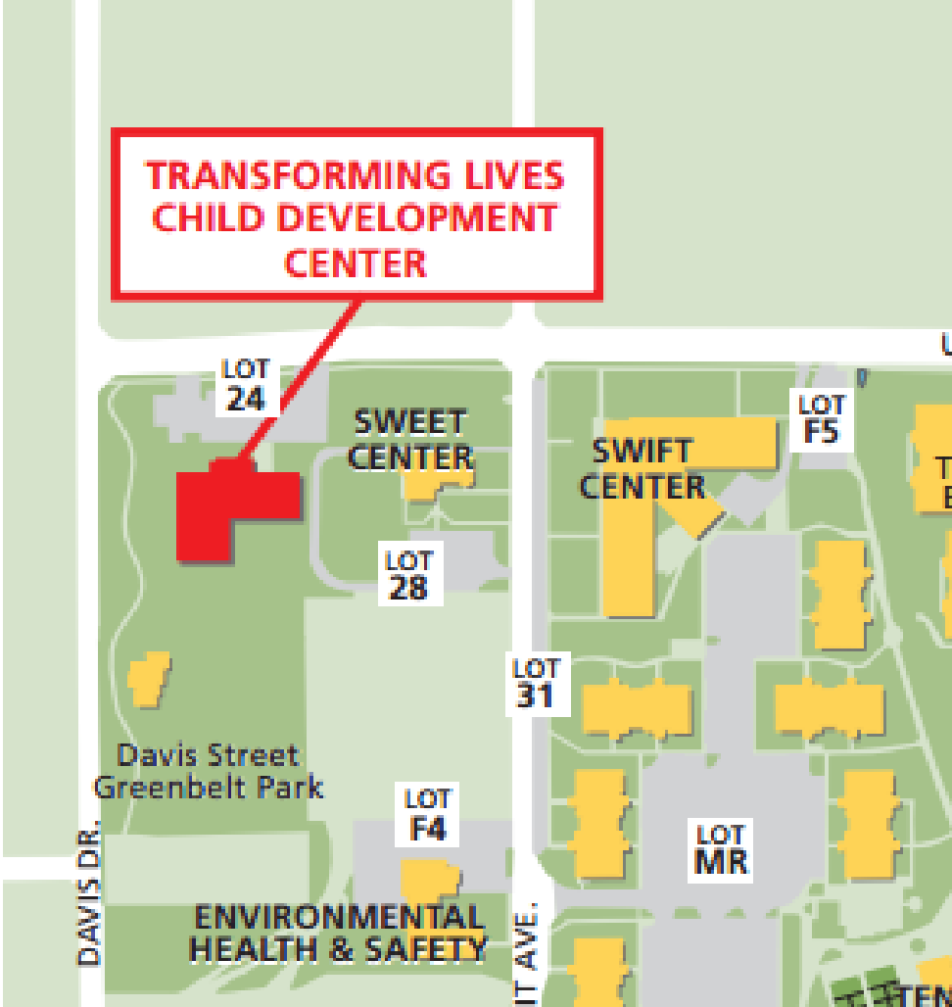
Exclusionary Areas
Handguns may not be carried into licensed childcare facilities, including the Transforming Lives Child Development Center located on campus.

Slide 22
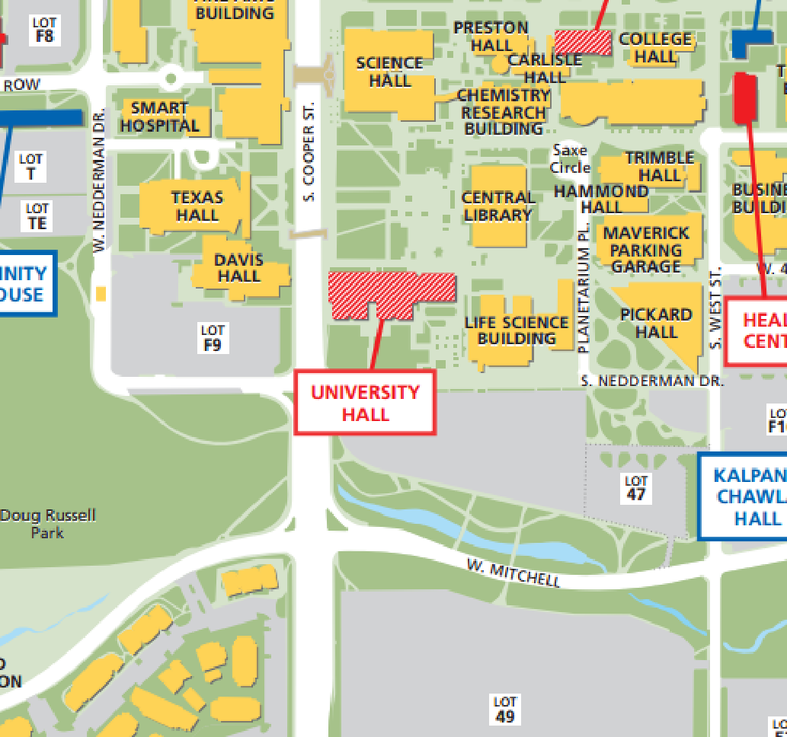
Exclusionary Areas
Handguns may not be carried into the Testing Services Offices located in University Hall.

Slide 23
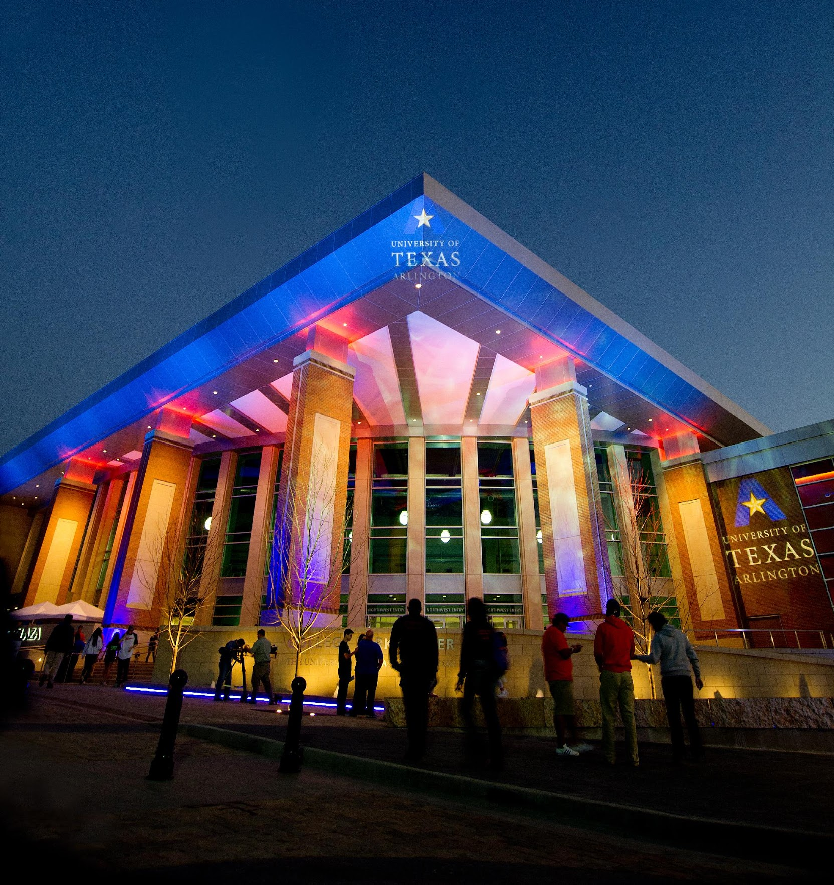
Exclusionary Areas
Handguns may not be carried into any high school, collegiate, or professional sporting event held on campus. Consequently, a LTC holder may not carry a handgun in the College Park Center, Maverick Stadium, Allan Saxe Field, and Clay Gould Ballpark or any other areas hosting one of these events.
Note: For collegiate sporting events, notice will be given on the tickets or through 30.06 signage.

Slide 24
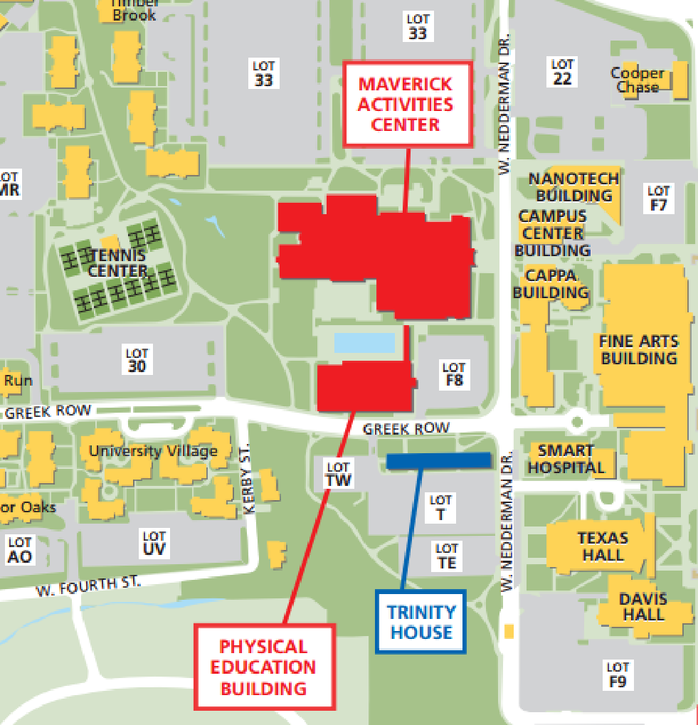
Exclusionary Areas
Handguns may not be carried into the Maverick Activities Center (MAC) or the Physical Education Building (PEB).

Slide 25
Exclusionary Areas
Handguns may not be carried into these areas providing counseling and health services: Social Work Building B, Counseling and Psychological Services on the third floor of Ransom Hall, and the Student Health Services Building.

Slide 26
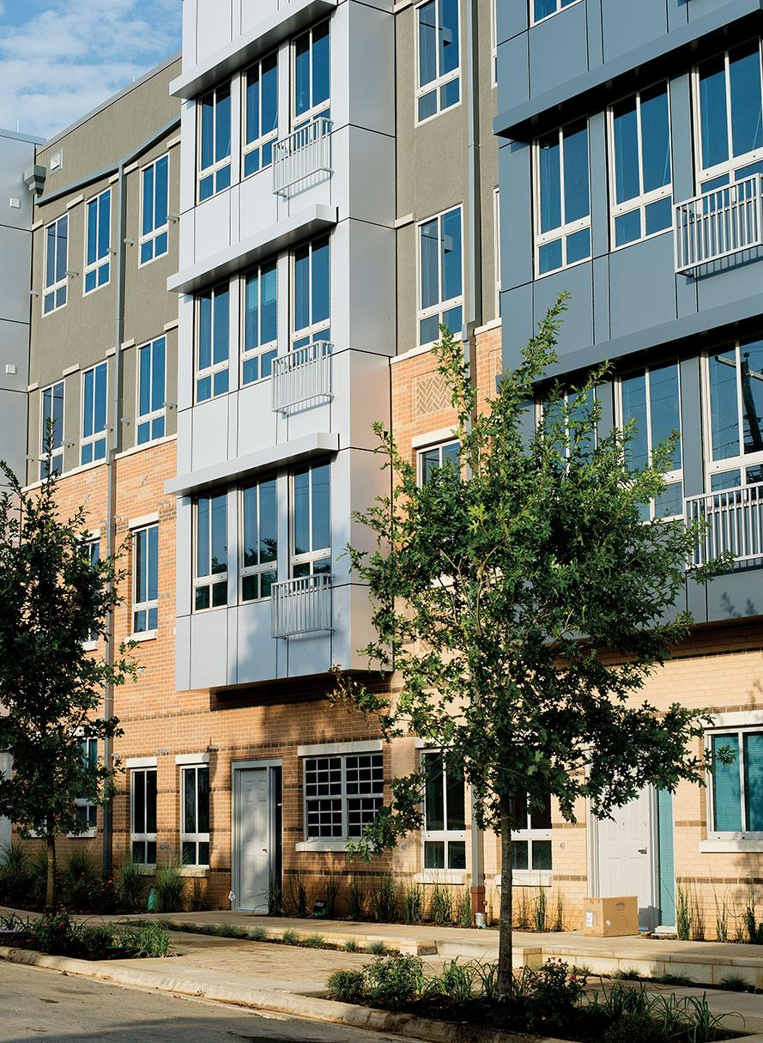
Exclusionary Areas
Handguns may not be carried into university-owned residence halls when being used for summer camps from May - August.
The university will be developing housing options for LTC holders in future years during summer camps.

Slide 27
Exclusionary Areas
Handguns may not be carried into any designated locations where formal disciplinary and grievance actions are conducted.
Note: These areas are temporary and only exclusion zones when a hearing is occurring. Notice will be provided to the participants.

Slide 28

Exclusionary Areas
Handguns may not be carried into any active polling place for public elections on campus.
This includes early voting and election day.
Note: These areas are temporary and are only exclusion zones when voting is occurring

Slide 29

Exclusionary Areas
Handguns may not be carried into any area on campus where a K-12 school event is taking place.
Note: These areas are temporary and are only exclusionary areas during the K-12 school event.

Slide 30
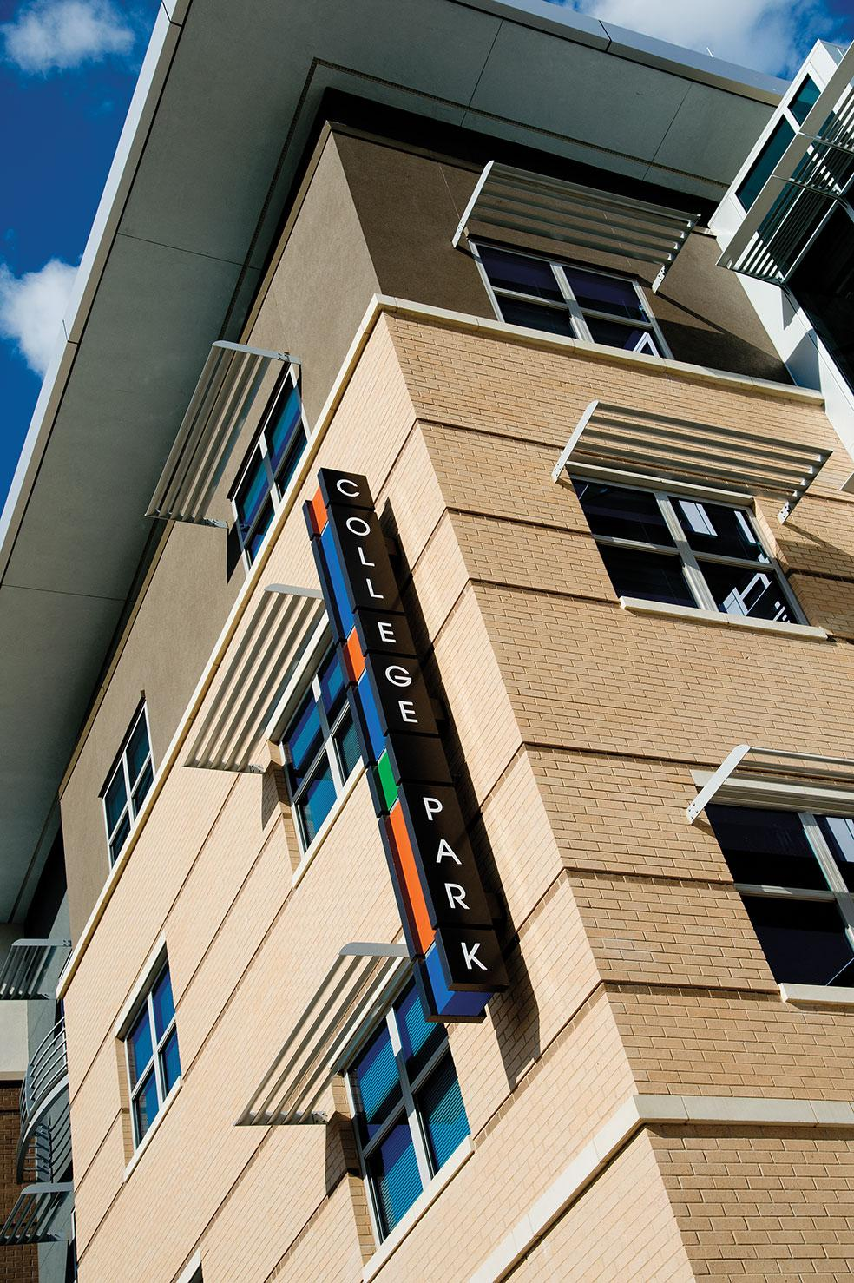
Exclusionary Areas
Other exclusionary areas may include leased space on the University Campus as determined by the lessee. Notice may be given by signage, orally, or by written materials. These areas include:
Centennial Court Apartments, Follett Bookstore, and restaurants, shops, and office space in the College Park District as designated by proper signage.

Slide 31
Exclusionary Areas
On a case-by-case basis and as determined by the UTA president, any location or specific time period during which an activity is conducted may create a unique situation that poses a threat to the safety of the campus community and therefore may be declared an exclusionary area.

Slide 32
Storage of Handguns
Gun safes will not be provided by the university. If you need to enter an exclusion area, you must secure your handgun in your vehicle or by other means. The university will not provide gun storage.

Slide 33
Specific Information for License to Carry (LTC) Holders
If you choose to carry a concealed handgun on campus, you are responsible for knowing where it can and cannot be carried. Employees who do not follow UTA policy are subject to discipline up to and including termination. Students who do not follow UTA policy are subject to discipline up to and including expulsion by the Office of Student Conduct.
Accidental discharge of a firearm is also cause for discipline up to and including termination for employees and up to and including expulsion for students.

Slide 34
Specific Information for License to Carry (LTC) Holders
Employees are not authorized to use their weapon in the course or scope of their job duties. Carrying is a personal decision.
Employees accept personal liability for any injury or damage resulting from the use of their handgun.
Employees required to respond to different areas of campus may be prohibited by departmental procedures from carrying a concealed handgun, even if the employee is a LTC Holder. Consult your supervisor or HR representative if clarification is needed.
Employees may not store their concealed handgun in a university-owned vehicle.

Slide 35
Know the Exclusionary Areas
Remember that there are certain places and types of activities where handguns are not allowed, including ticketed sporting events, the MAC and PEC, certain areas on campus, and more. Please review the information in the “Exclusionary Areas” section of this presentation and the UTA policy.

Slide 36
Questions About the Policy?
If you have questions about this policy, please visit uta.edu/campuscarry to submit comments or use the committee’s email address at campuscarry@uta.edu.

Slide 37
Additional Resources
Campus Carry Policy HOP 12-500
Campus Carry website, including Frequently Asked Questions
Texas Senate Bill 11, 84th Legislature (SB 11), the “campus carry” law
Texas Department of Public Safety, LTC Information
Texas Government Code for DPS
Texas Penal Code applicable to weapons

Slide 38
Additional Resources
University Housing Handbooks and Guidelines
Summer Camp Guide for UT Arlington Divisions/Departments
The University of Texas at Arlington Police Department – 817.272.3381
University Compliance and Legal Affairs – 817.272.2142

Slide 39

Thank you!

