Slide 1
UNCLASSIFIED
Wide Area Workflow (WAWF)
David Kern
Small Business Professional
david.k.kern2.civ@army.mil
28 February 2024
UNCLASSIFIED

Slide 2
Wide Area Workflow (WAWF)
PIEE Registration
Creating/Submitting Invoices
Tracking Your Payment (MyInvoice)
AskDFAS

Slide 3
Procurement Integrated Enterprise Environment (PIEE)
PIEE Modules:
Wide Area Workflow (WAWF)
MyInvoice
Users must register (Vendors and Government):
https://piee.eb.mil

Slide 4
PIEE REGISTRATION

Slide 5
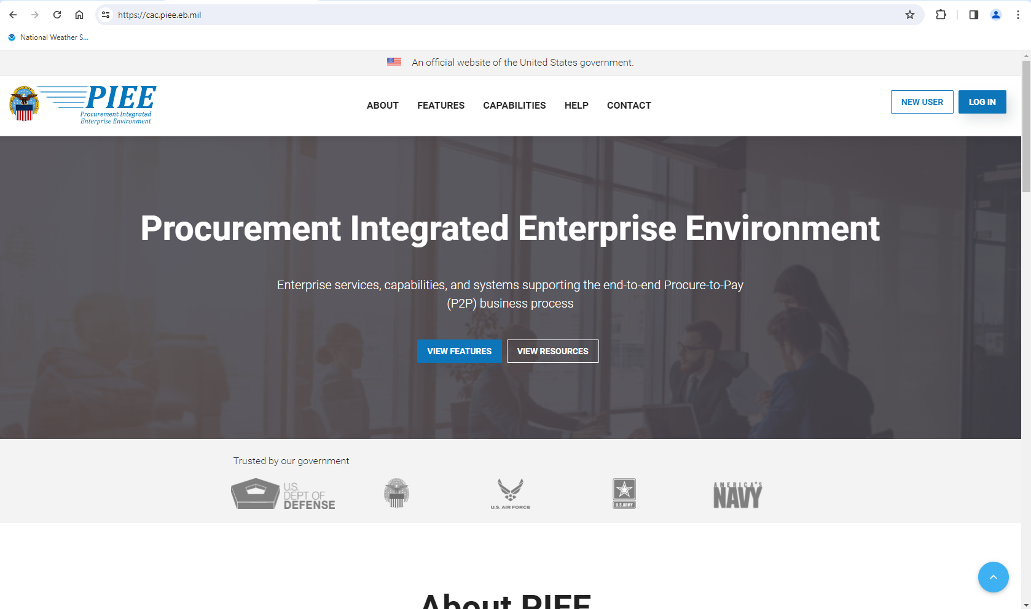
Notes:
The homepage has been changed with the latest release of PIEE.

Slide 6
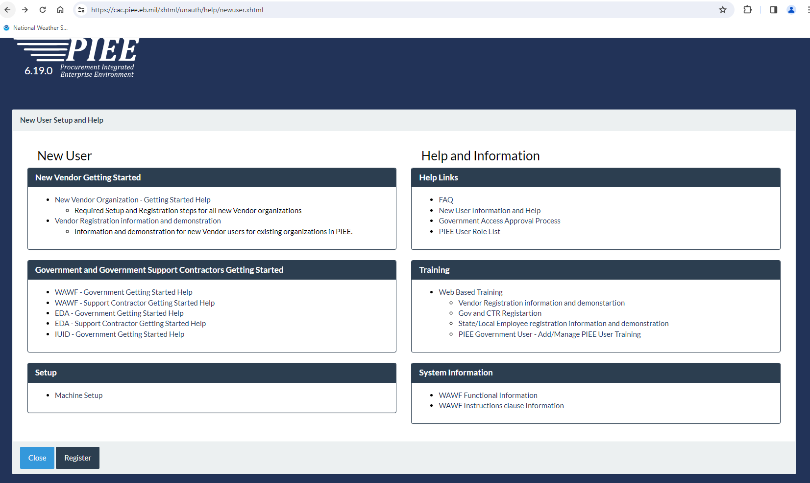

Slide 7
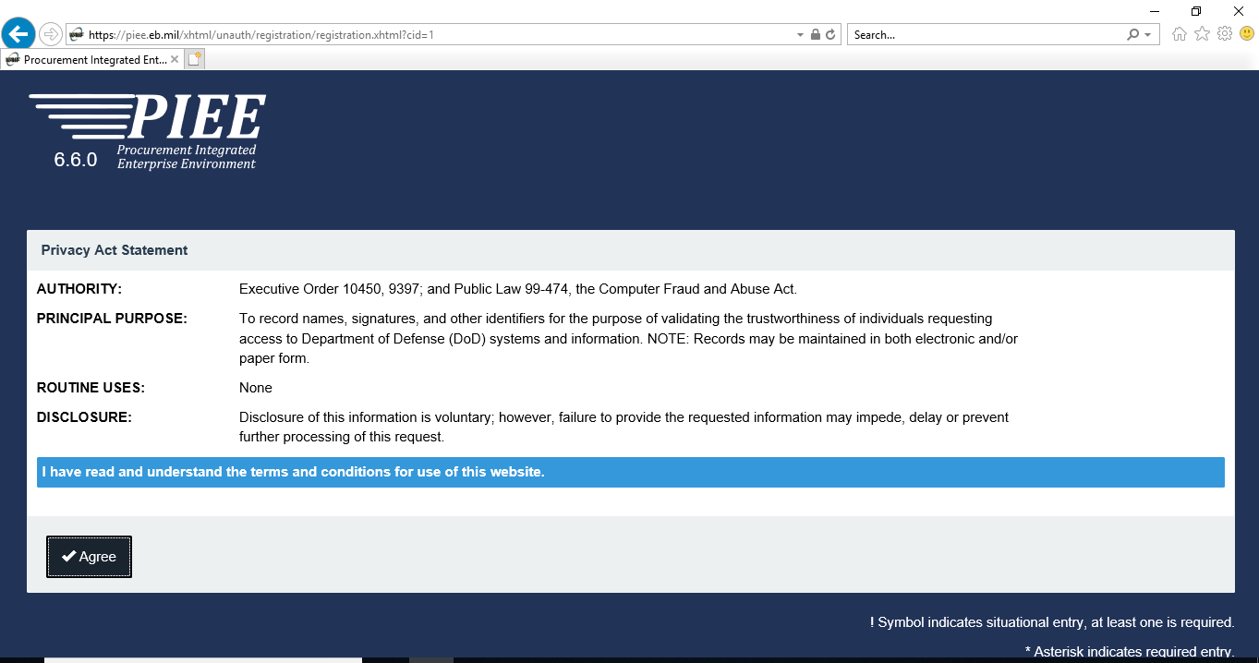
Notes:
Take note in the bottom right hand corner - * Asterisk denotes required entry. TIP: Only provide required information. It will simplify registration and invoice submission.

Slide 8
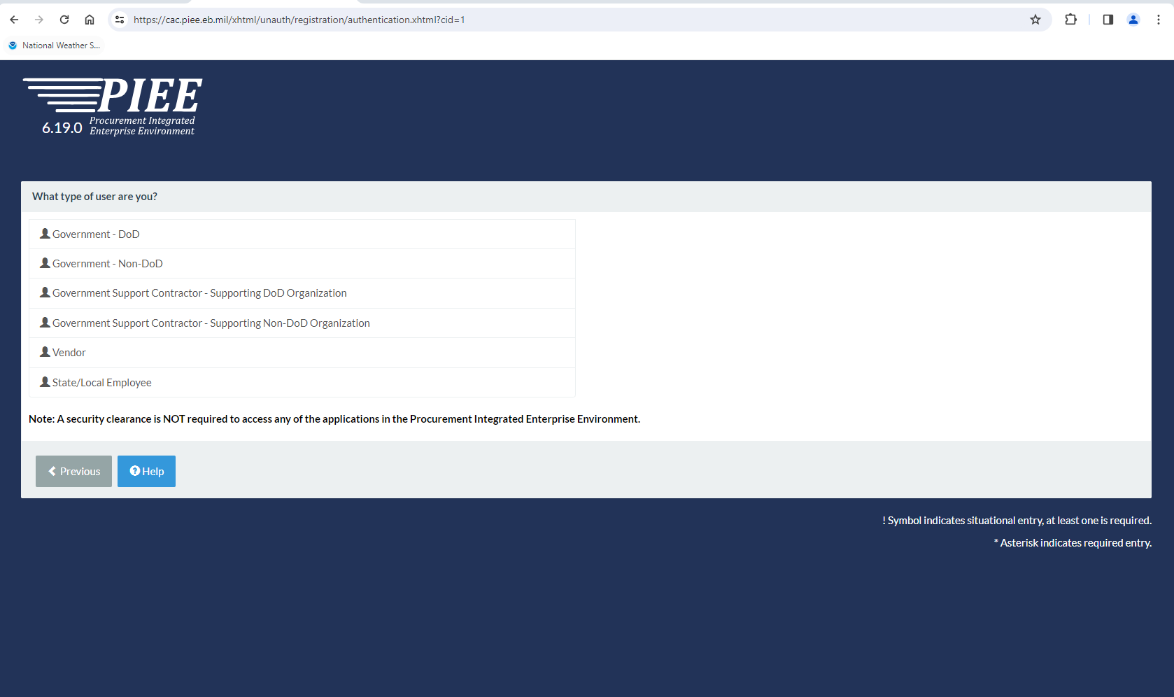

Slide 9
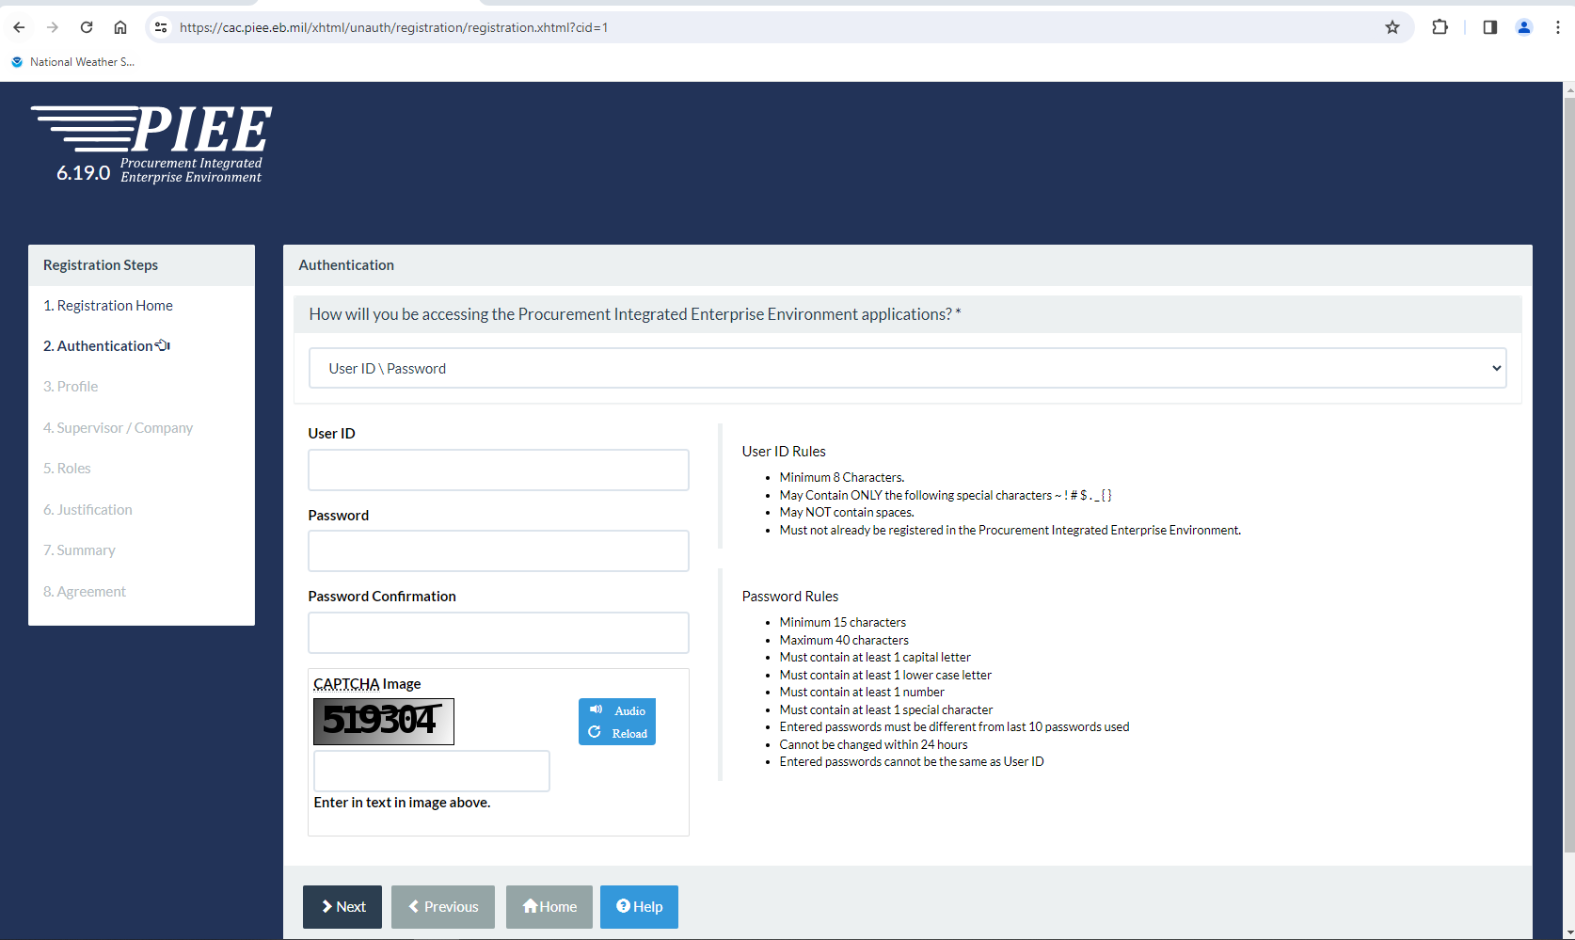

Slide 10
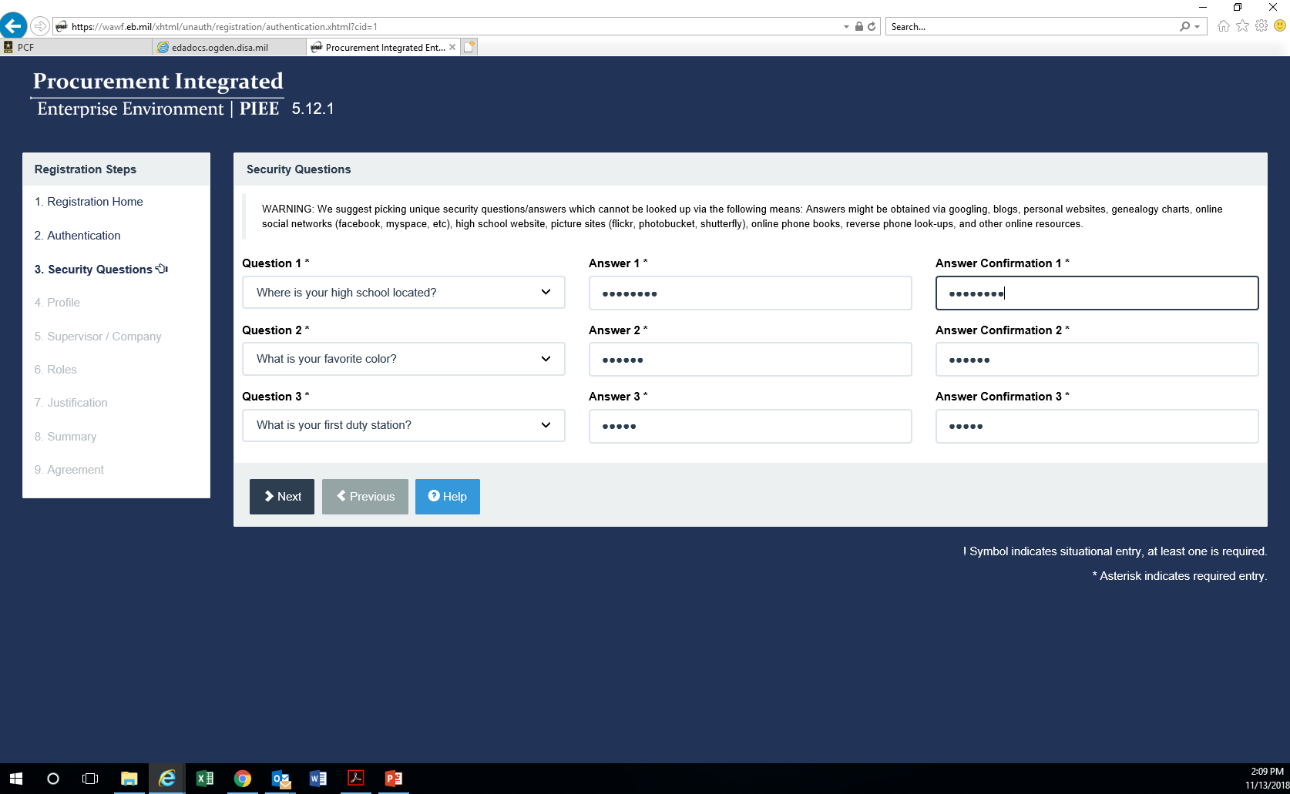
Notes:
Only need to complete the mandatory fields marked with an asterisk(*). Commercial telephone (!) is also required.

Slide 11
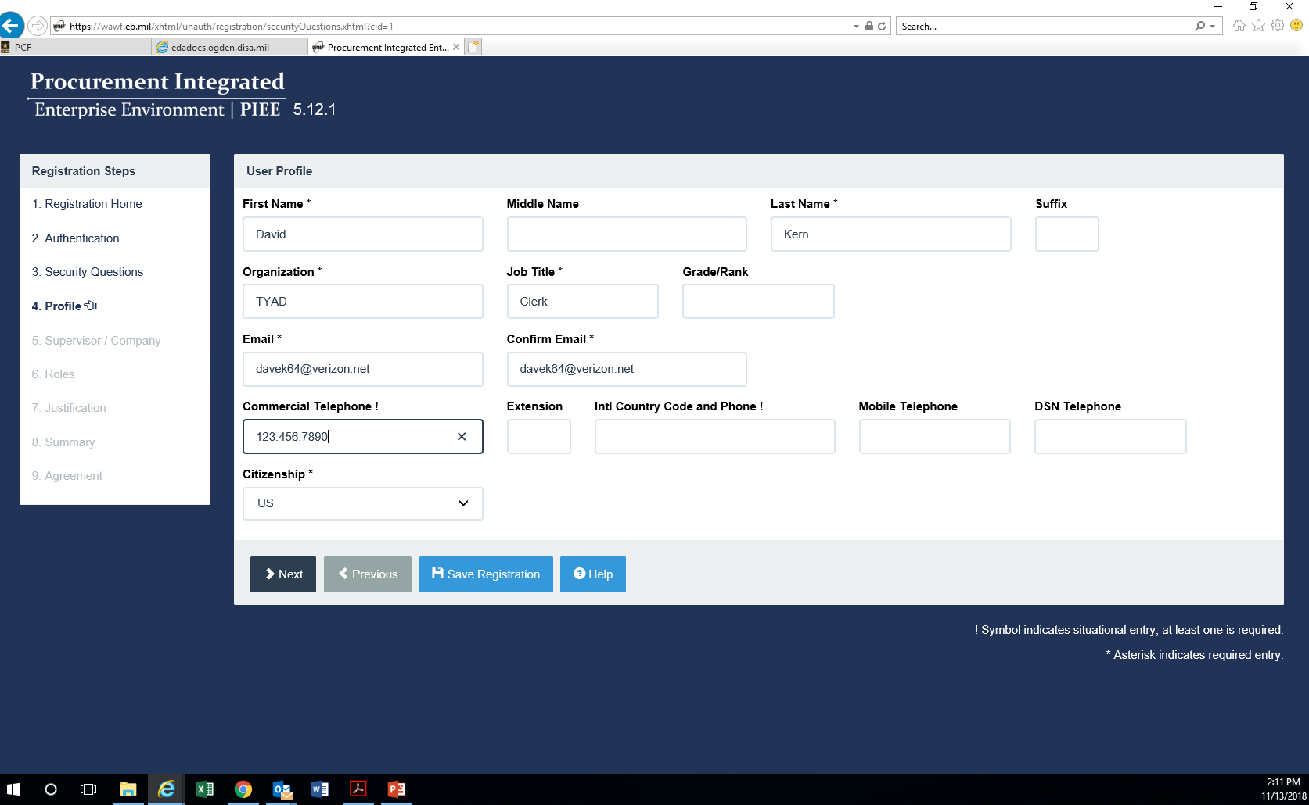
Notes:
Only need to complete the mandatory fields marked with an asterisk(*). Commercial telephone (!) is also required.

Slide 12
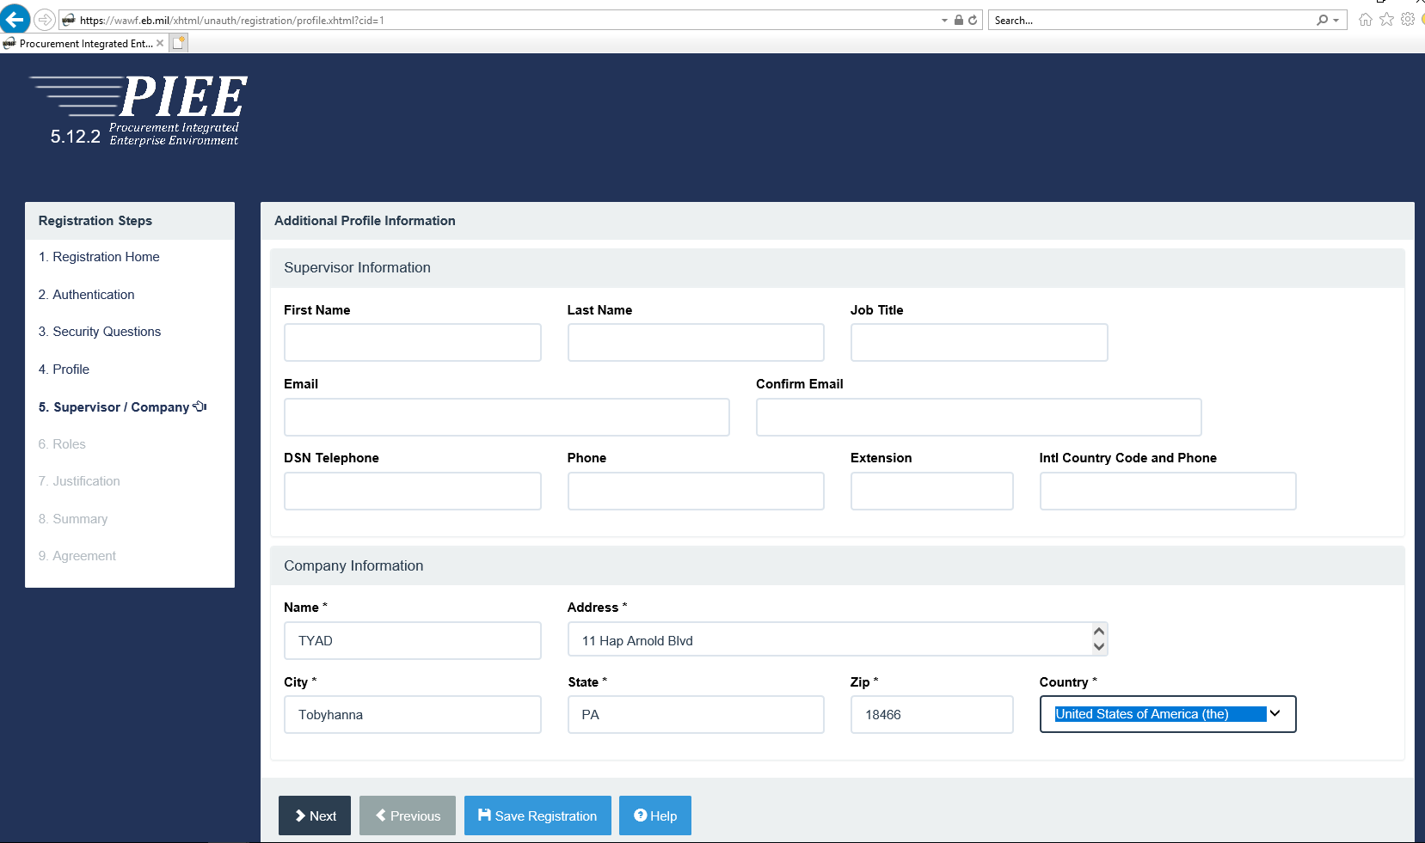

Slide 13
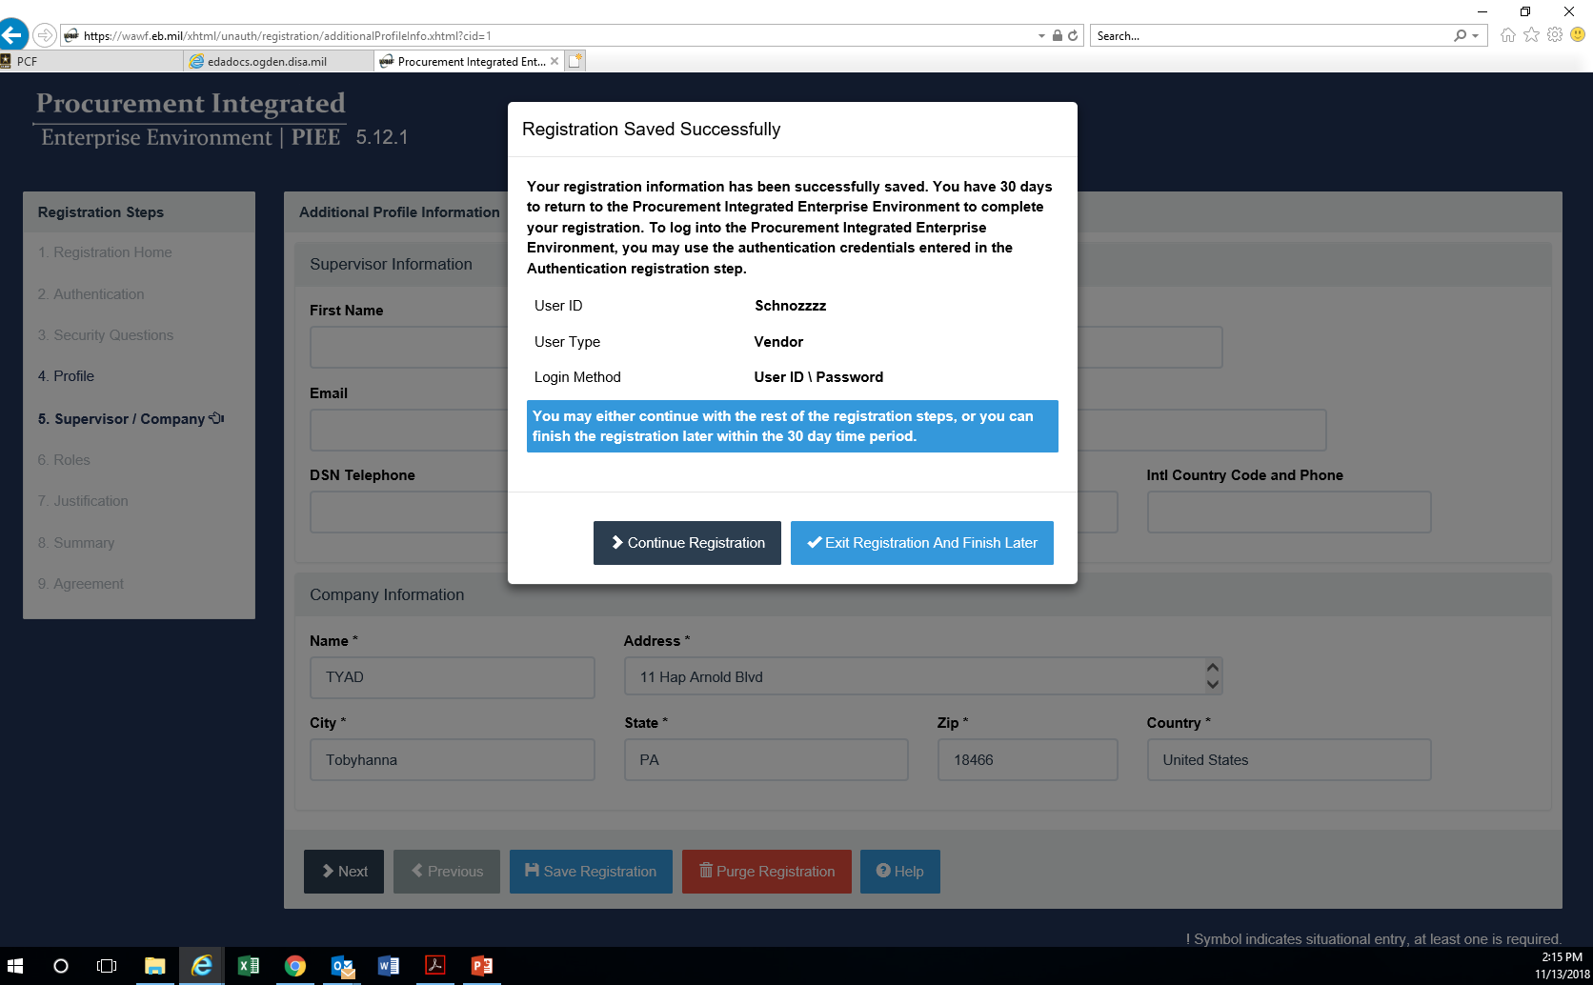

Slide 14
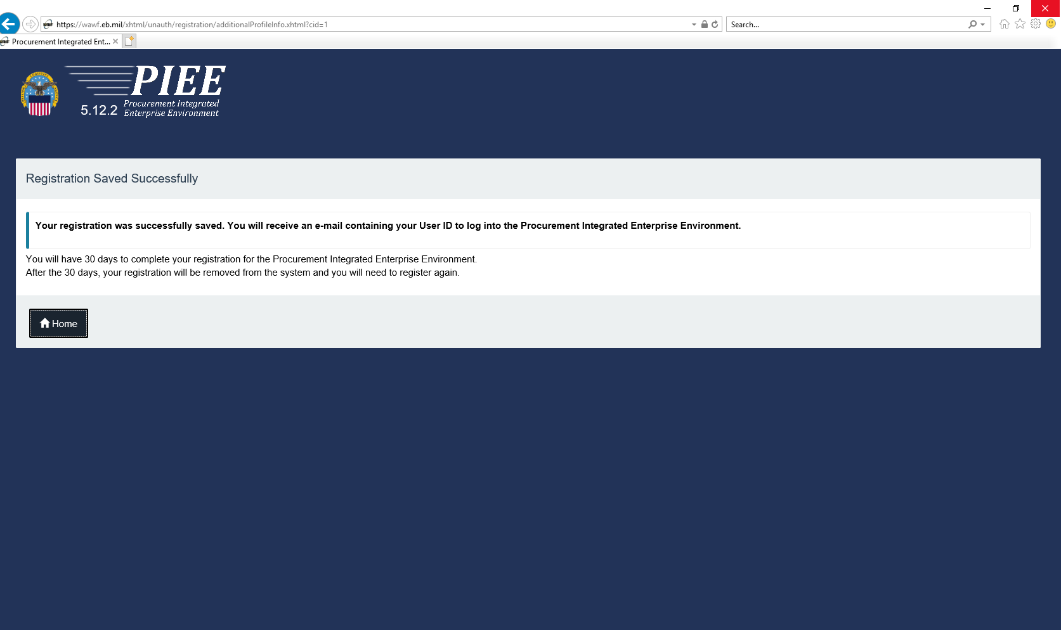

Slide 15
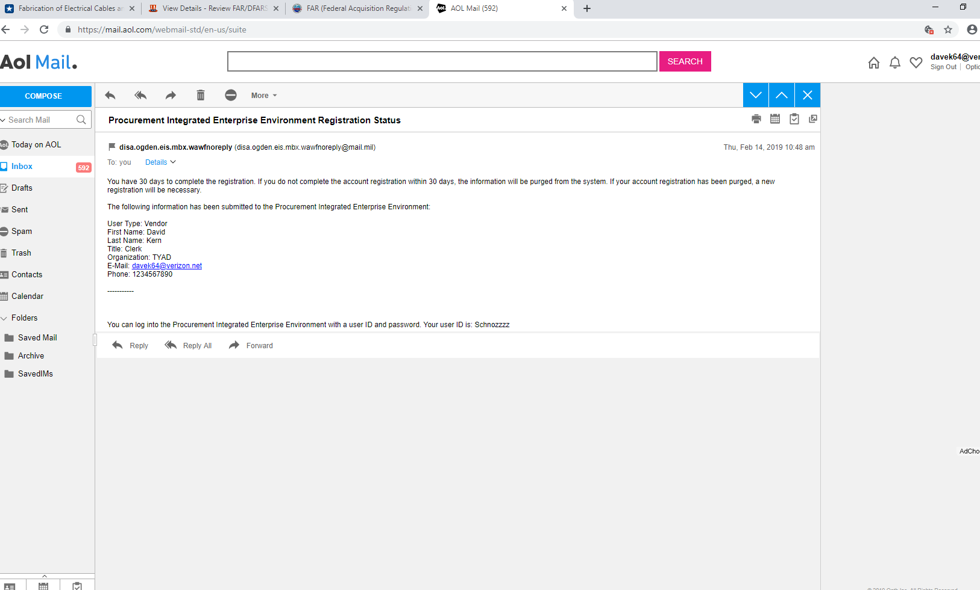

Slide 16
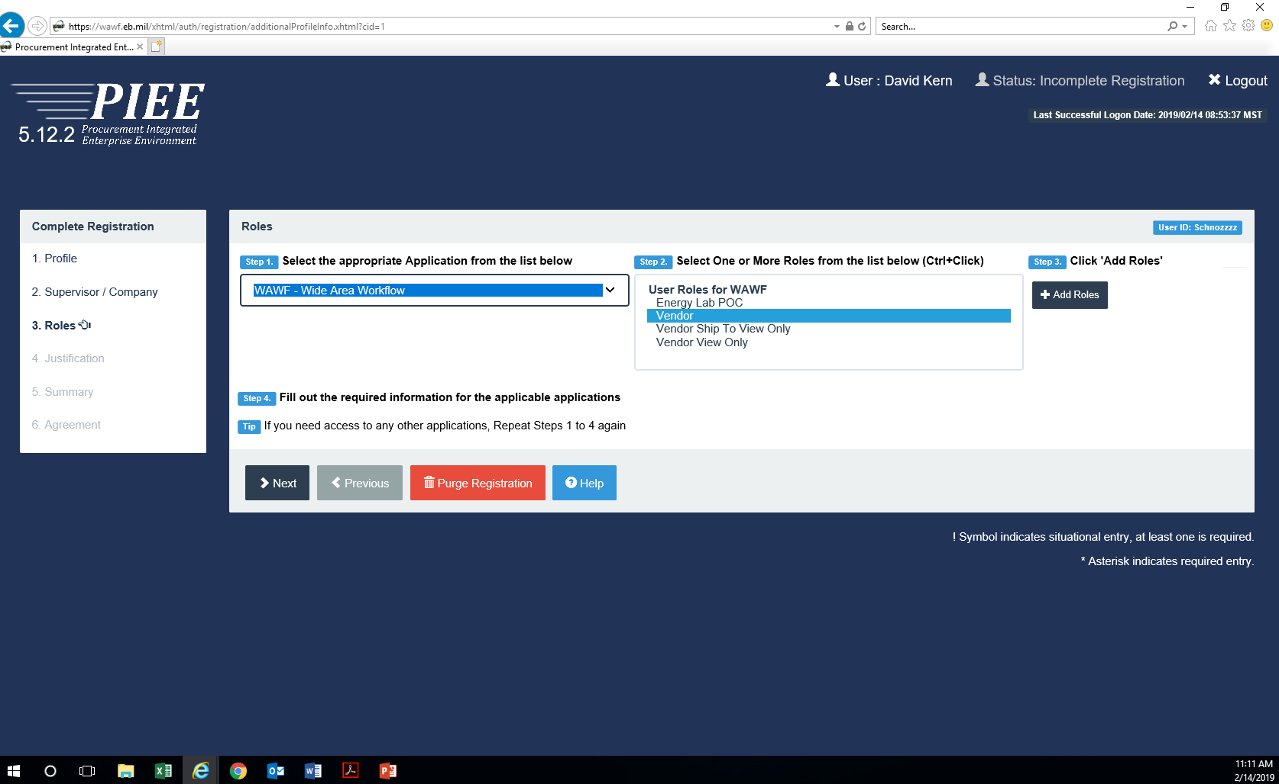

Slide 17
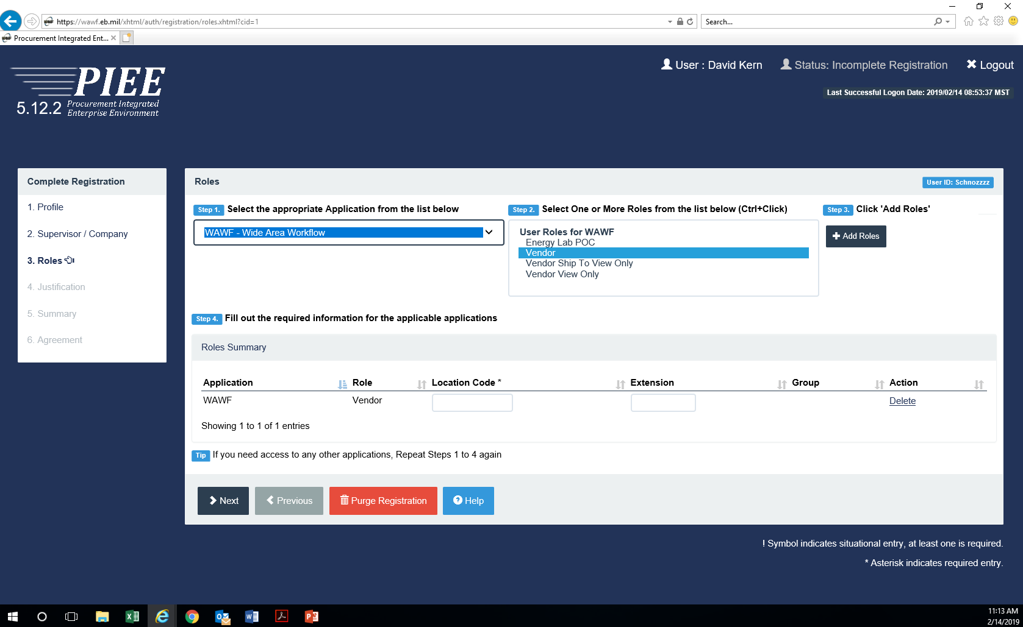

Slide 18
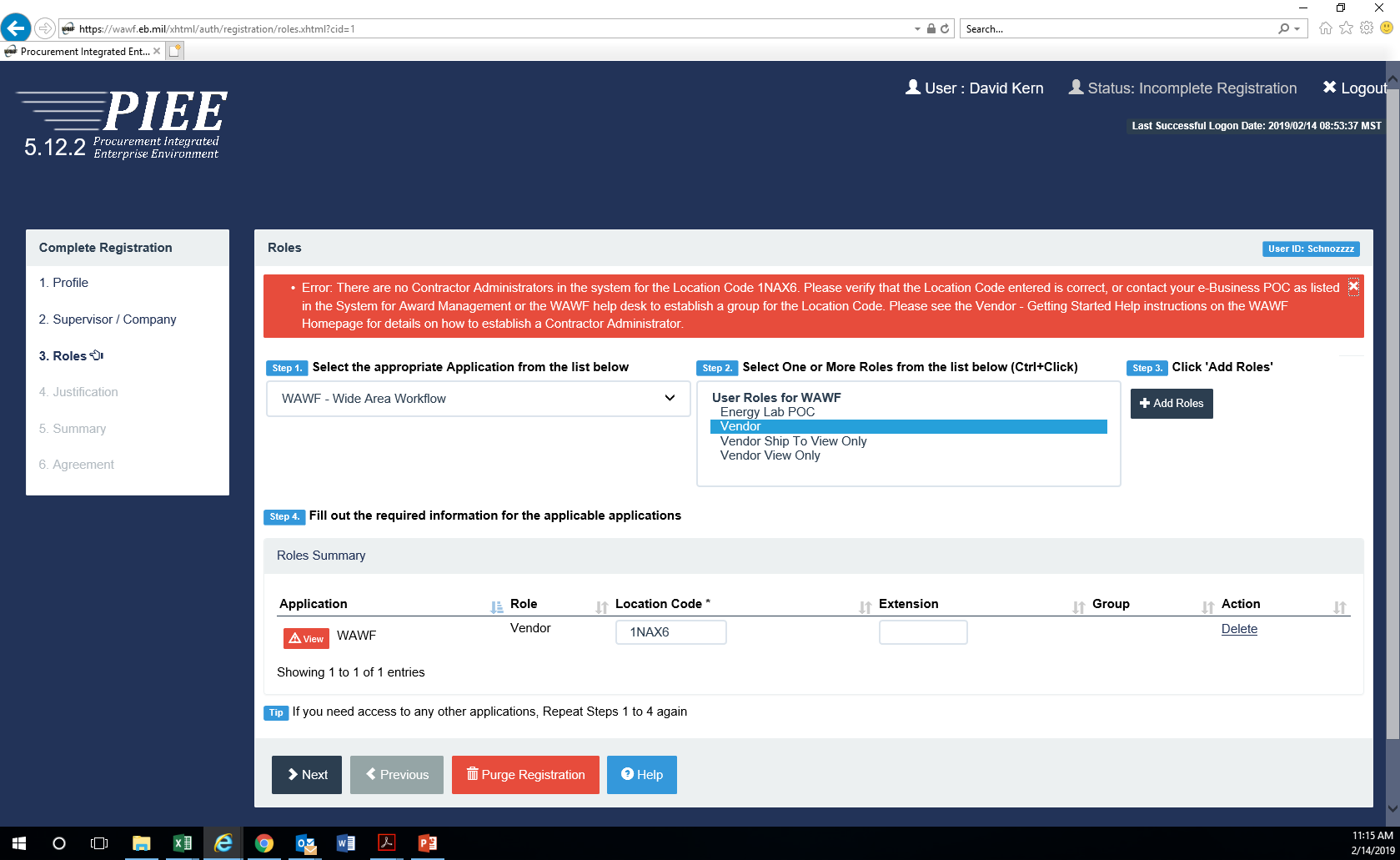
Notes:
First time users will need to contact the PIEE Technical Support Desk @ 866.618.5988 (opt 2, opt 3) to have the CAGE Code loaded into the system. The Contract Administrator (CAM) is the E-Business Point of Contact from the vendor’s SAM profile. A CAM appointment letter will need to be completed and returned if the user is not the CAM.

Slide 19
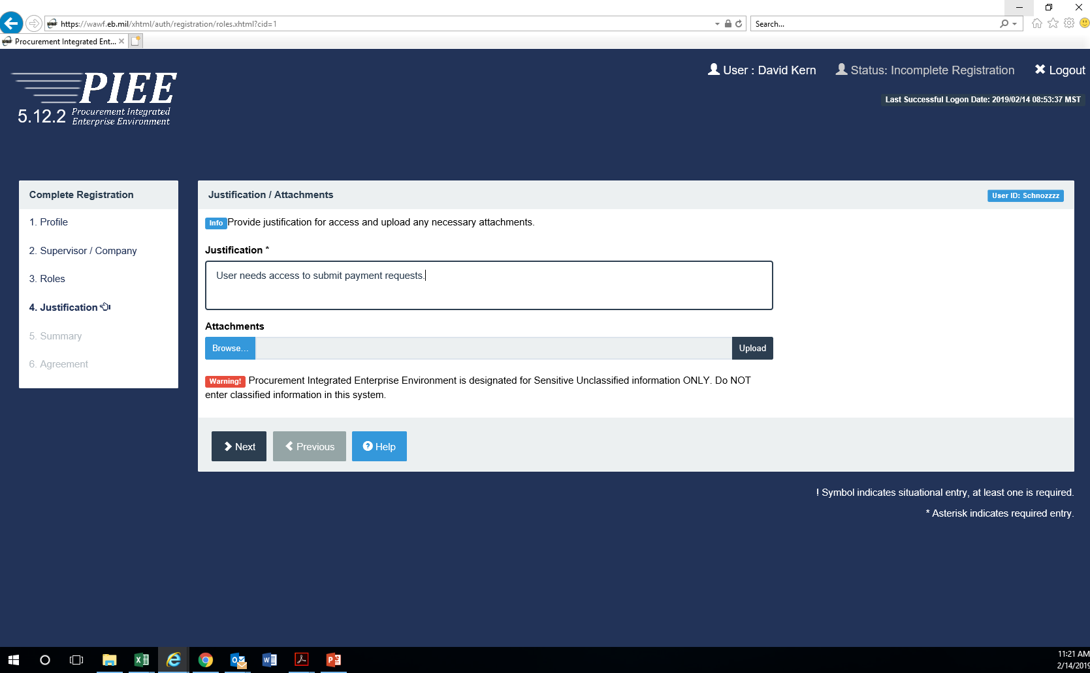

Slide 20
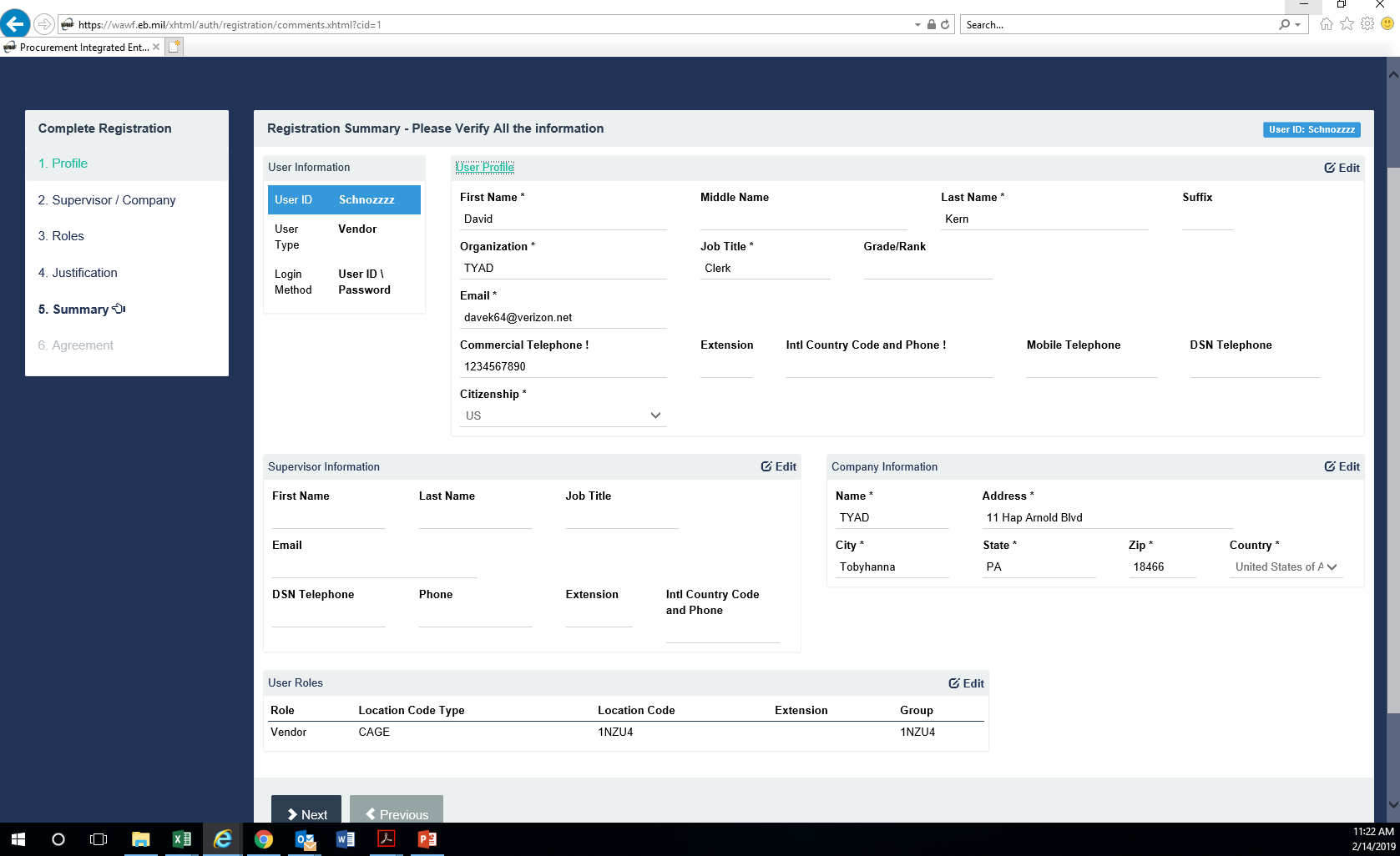

Slide 21
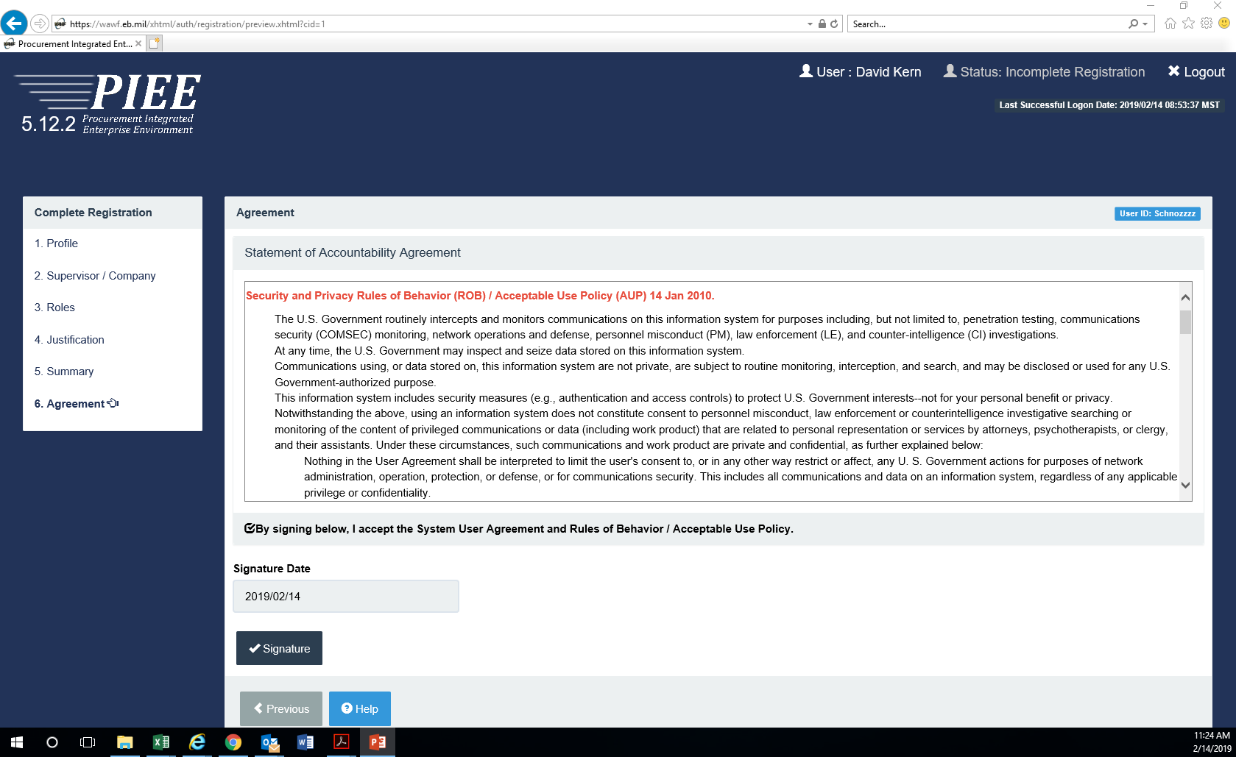

Slide 22
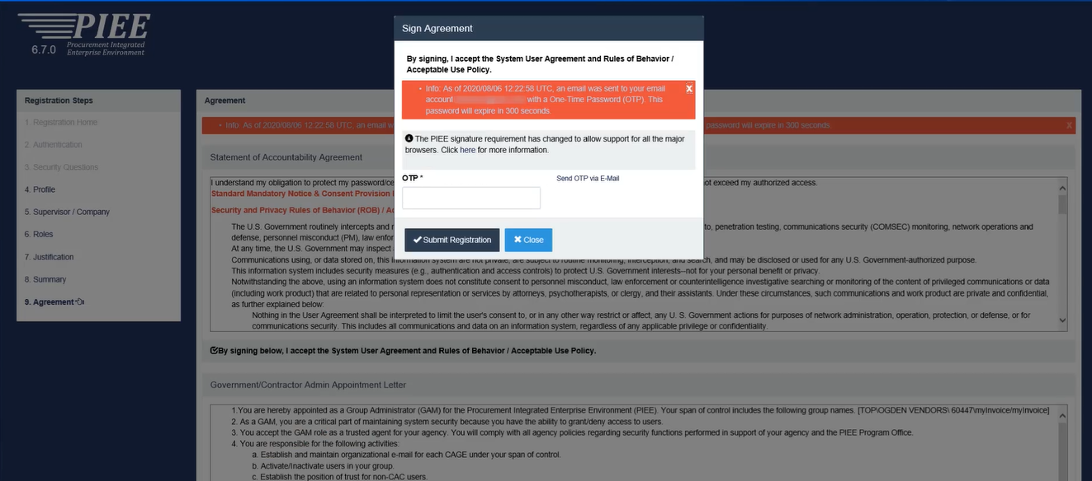
Notes:
First time users will be prompted to enter a One Time Password (OTP) before the profile can be activated. The password will be sent to email address in the profile. Users enter the password into the field provided and submit the registration request.

Slide 23
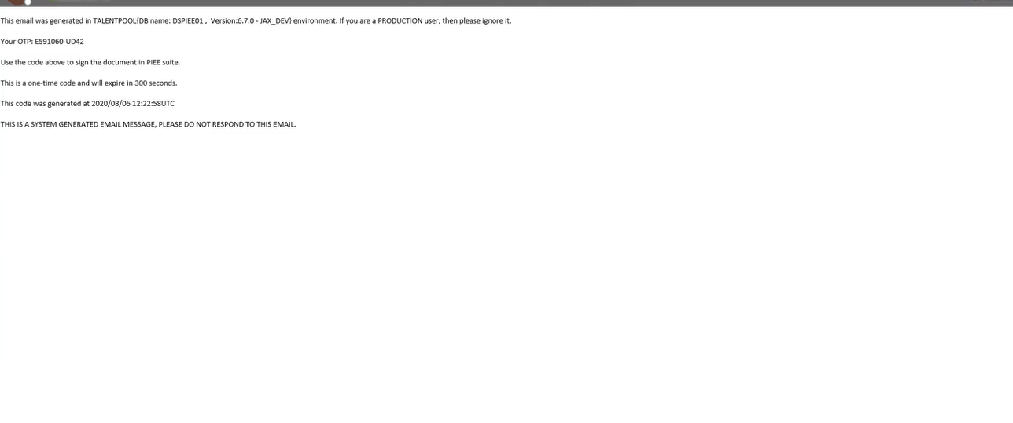

Slide 24
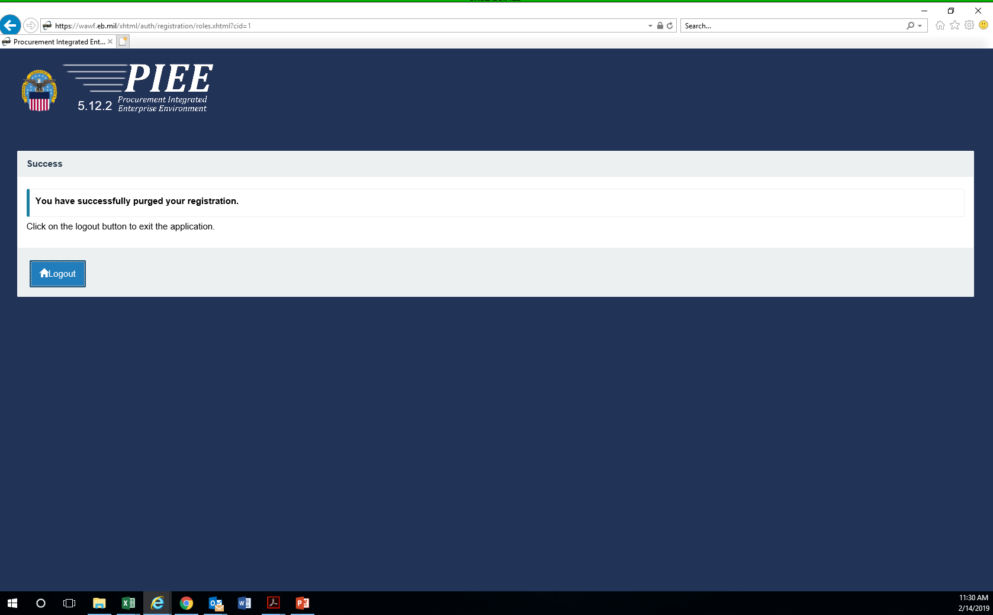
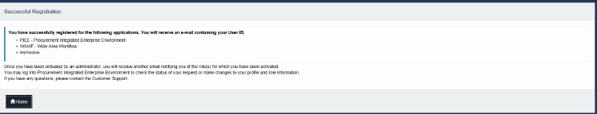

Slide 25
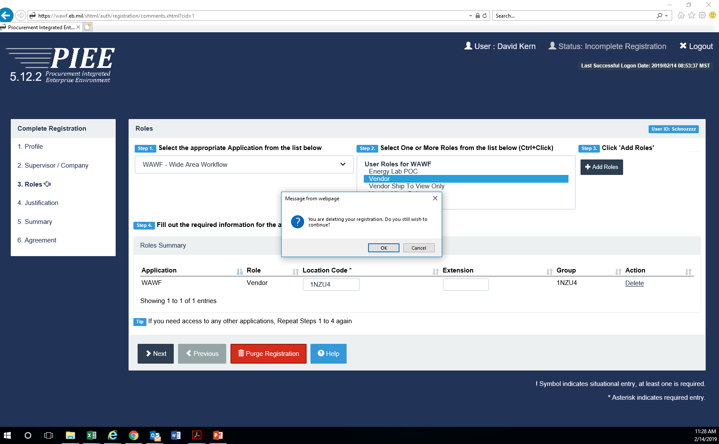

Slide 27
Vendor Role Options
Vendor (most common choice) – gives the user ability to create and submit documents, check status of submitted documents, edit and resubmit rejected documents.
Vendor View Only – review documents and check status but cannot make edits.
Contractor Property Shipper/Property Receiver – when transferring/receiving with Government Furnished Property, users can create and submit documents, review documents and reject documents.

Slide 28
Wide Area Workflow (WAWF)
First time users will need their CAGE Codes activated before they can finish registration. A Contract Administrator (CAM) will need to be established. A CAM appointment letter is required if the CAM is not the E-Business point of contact from the Vendor’s System for Award Management profile.
Passwords need to be reset every 60 days.
WAWF Help Desk – 866.618.5988 (opt 1, opt 2 or 5)
Notes:
Vendors will receive email reminders from PIEE with seven (7) days of the account expiring. So look for a system generated email from Defense Information Systems Agency (DISA). Option 2 is for account activation. Option 5 is for Technical Support (other issues?).

Slide 29
QUESTIONS?

Slide 30
Wide Area Workflow (WAWF)
Two Defense Federal Regulation (DFAR) clauses are inserted when WAWF is the payment method:
252.232-7003 - Electronic Submission of Payment Requests and Receiving Reports (referenced)
252.232-7006 – Wide Area Workflow Payment Instructions (full text and fill-in)

Slide 31
Wide Area Workflow (WAWF)
From DFAR 252.232-7002(b)(1):
“The only acceptable form for submission of payment requests and receiving reports is Wide Area Workflow (WAWF) https://piee.eb.mil/...”
and (b)(2):
- “Facsimile, email, and scanned documents are not acceptable forms of payment requests…..”

Slide 32
Wide Area Workflow (WAWF)
Wide Area Workflow Payment Instructions (252.232-7006) provides detailed instruction about the type of document to create and who the Acceptor is. That is, who at the government facility will process the document in order for the vendor to get paid.
Notes:
If the clause is not in full text and completed, contact the contracting office in the contract for guidance.

Slide 33
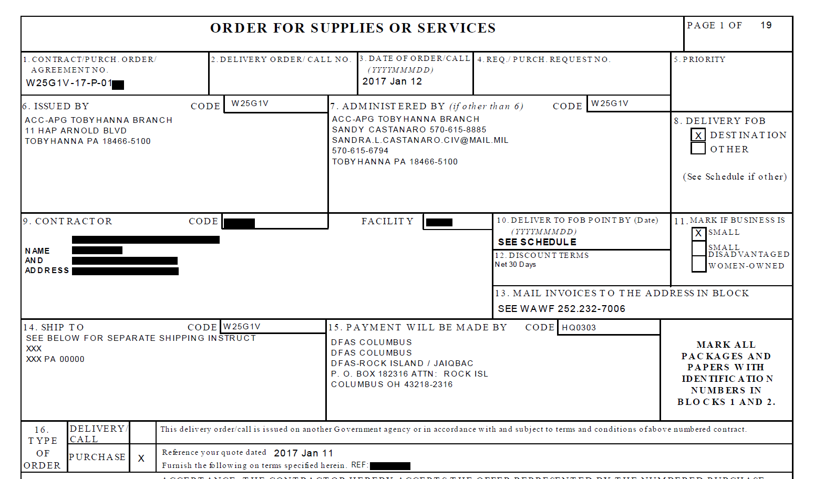
Notes:
If this purchase order is paid by credit card, the card number, etc., would appear in Block 15 instead of the DFAS Payment Office.

Slide 34
Wide Area Workflow (WAWF)
Three document types:
  Invoice and Receiving Report (COMBO)
  Invoice 2-In-1 (Services Only)
  Construction Payment Invoice (formerly Construction and Facilities Management Invoice)

Slide 35
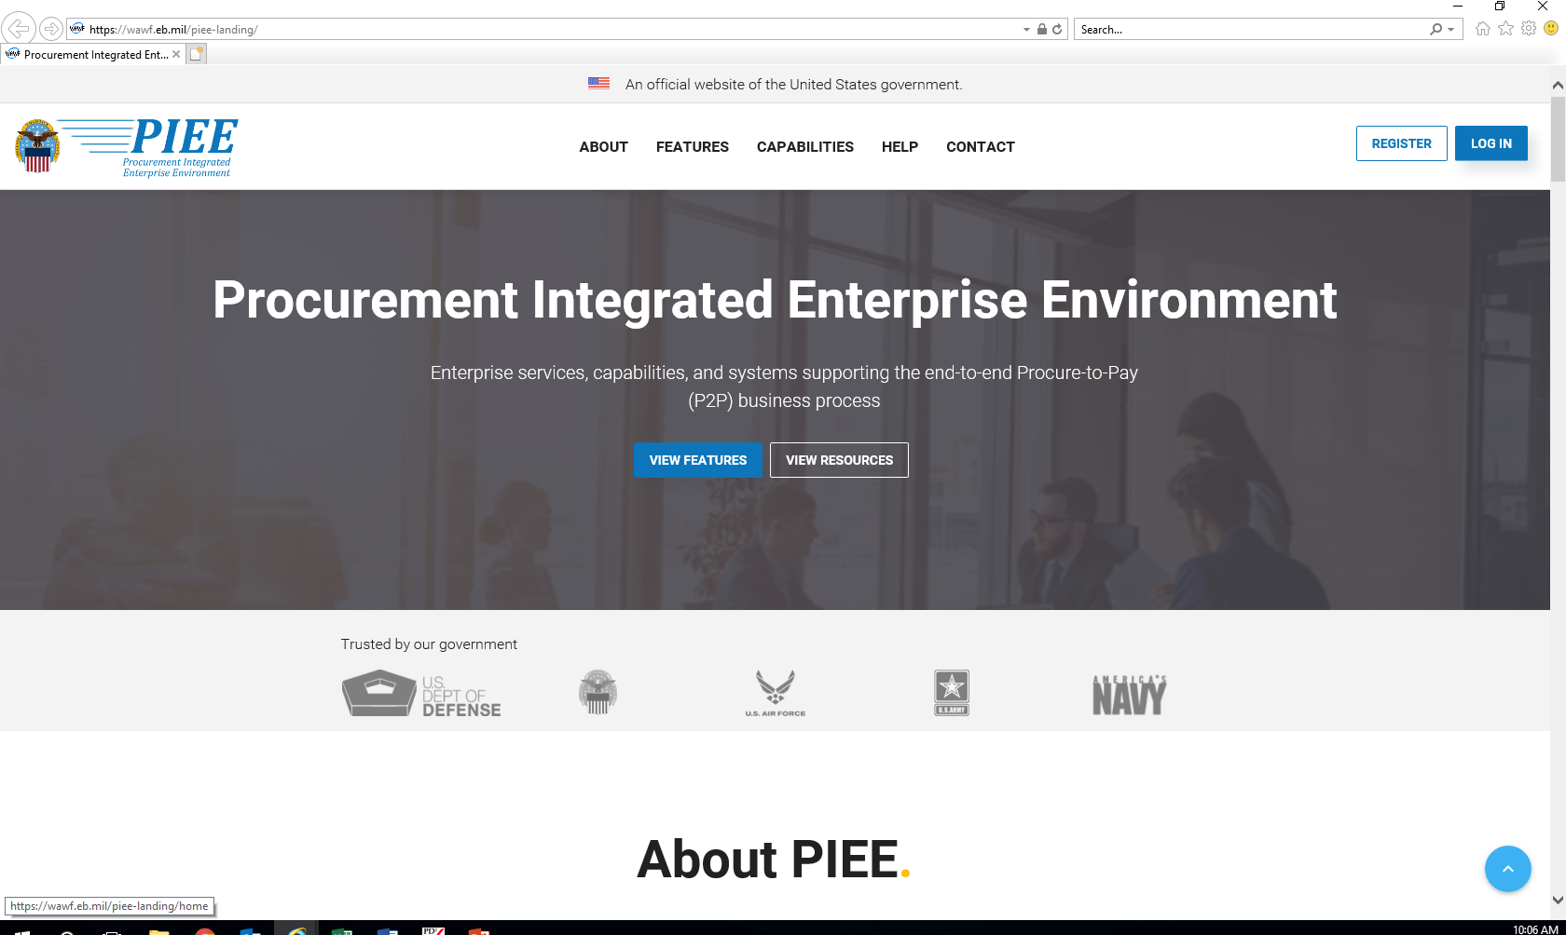

Slide 36
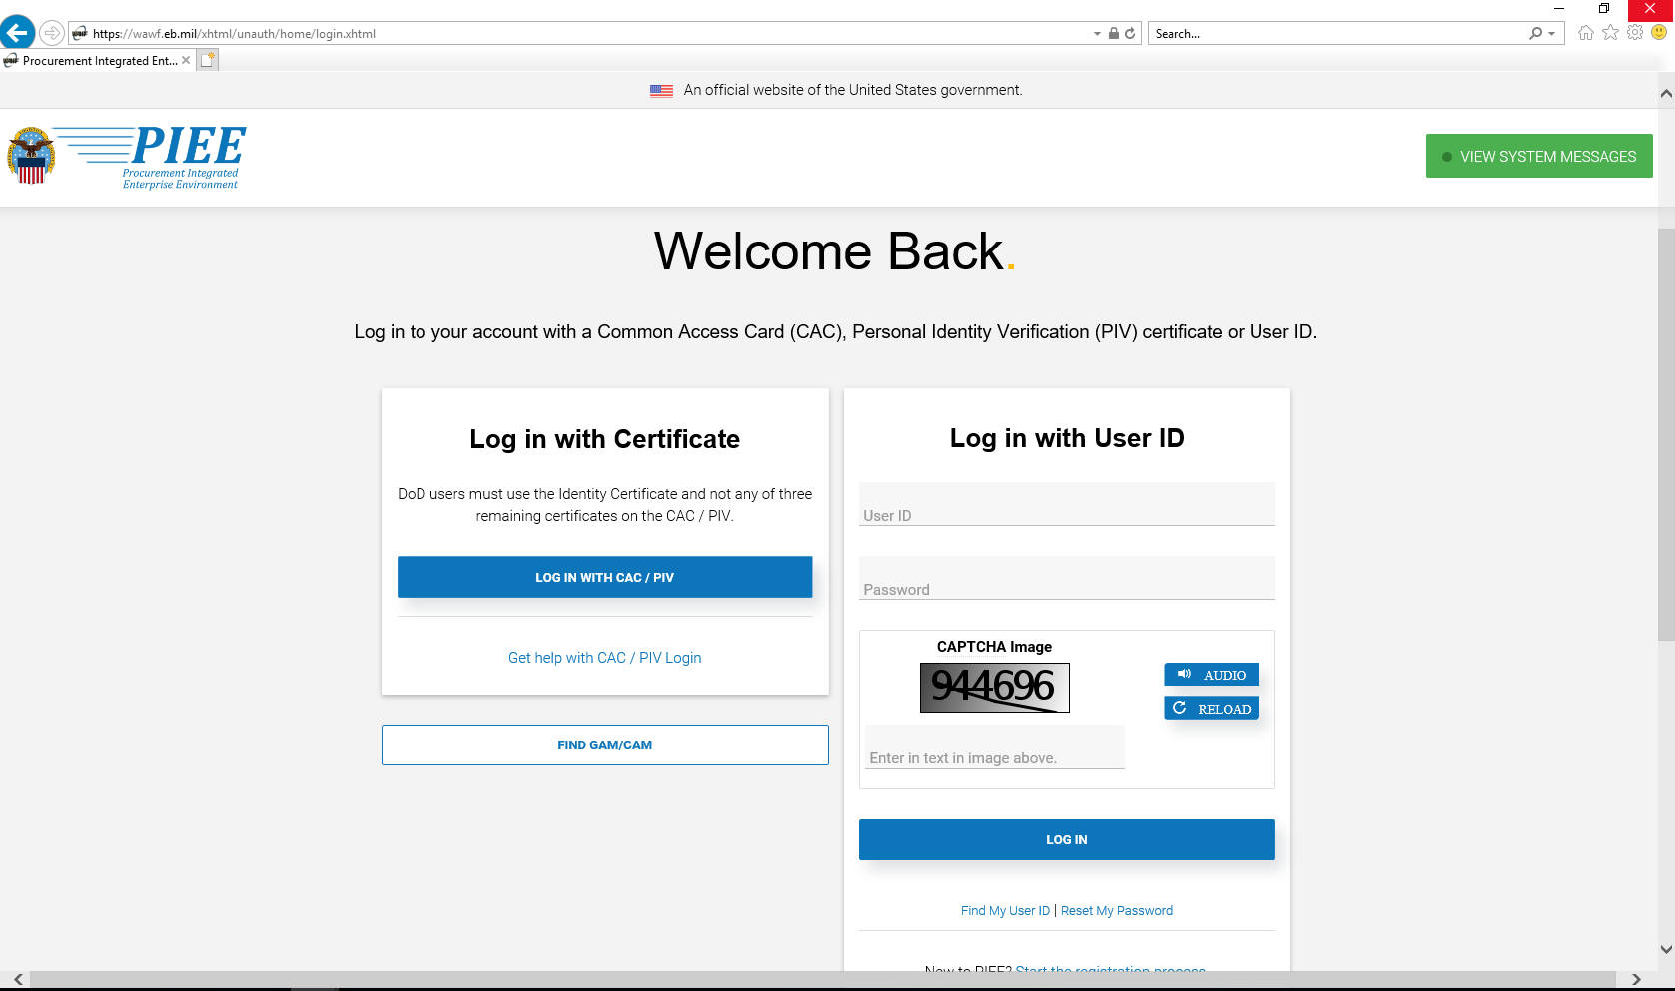

Slide 37
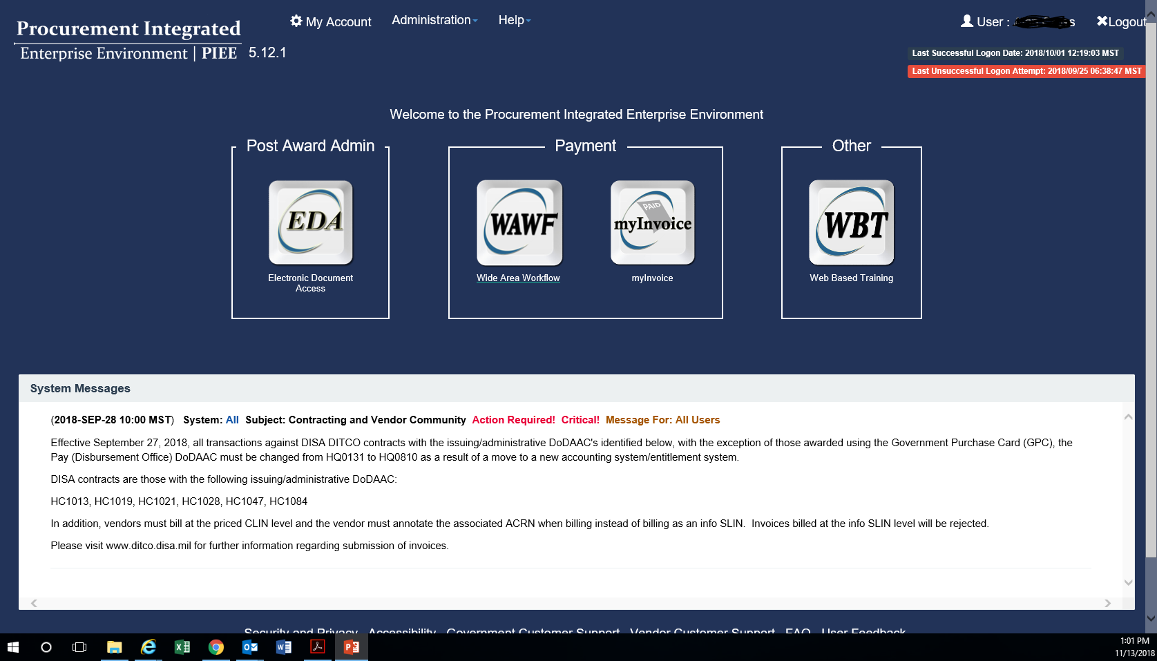

Slide 38
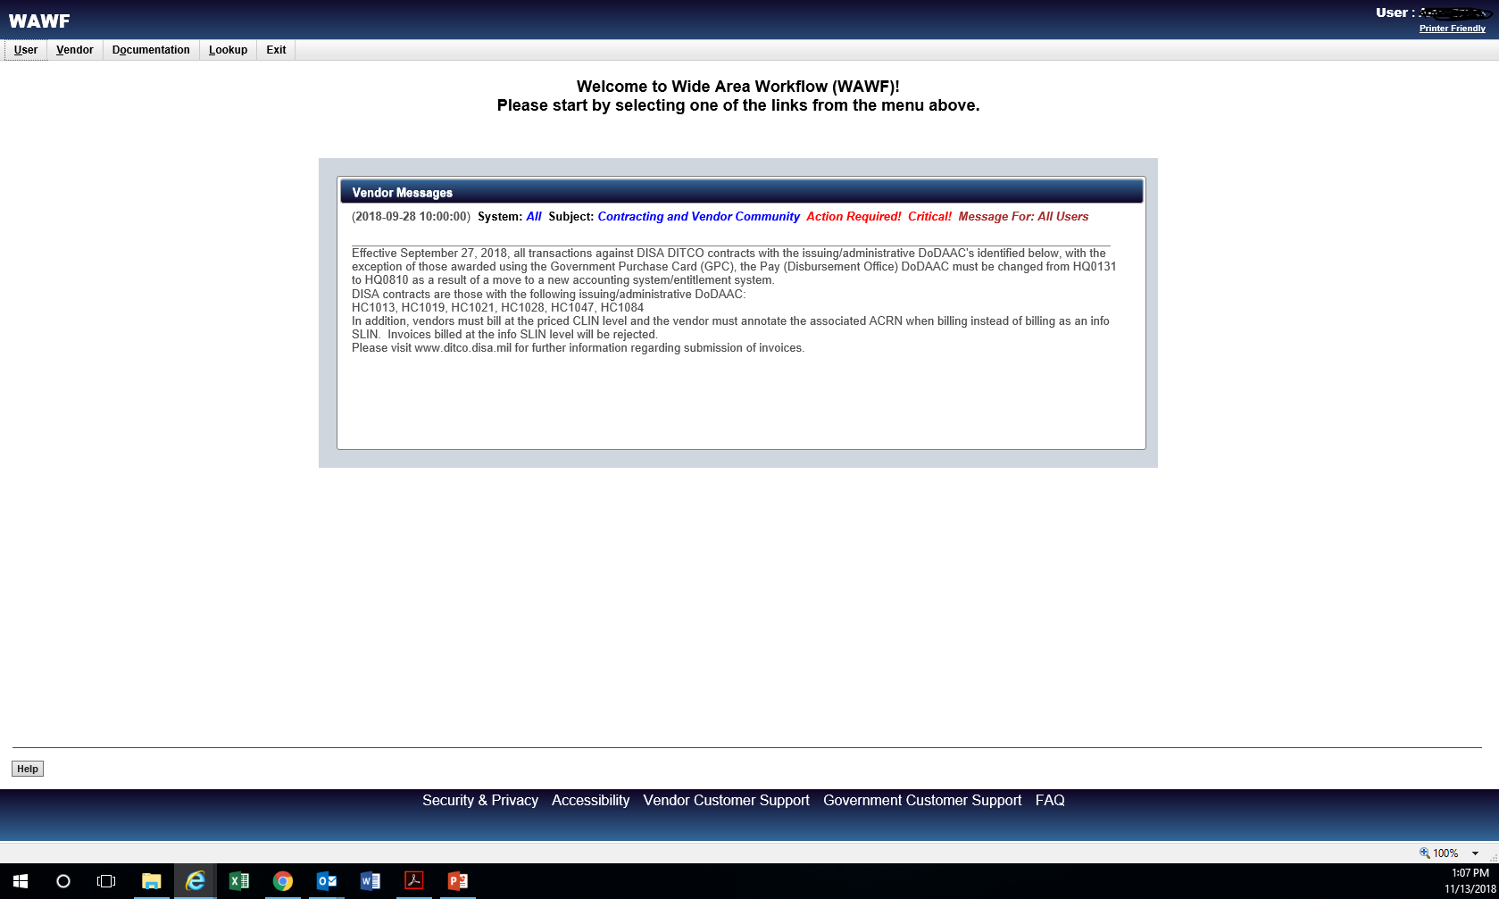

Slide 39
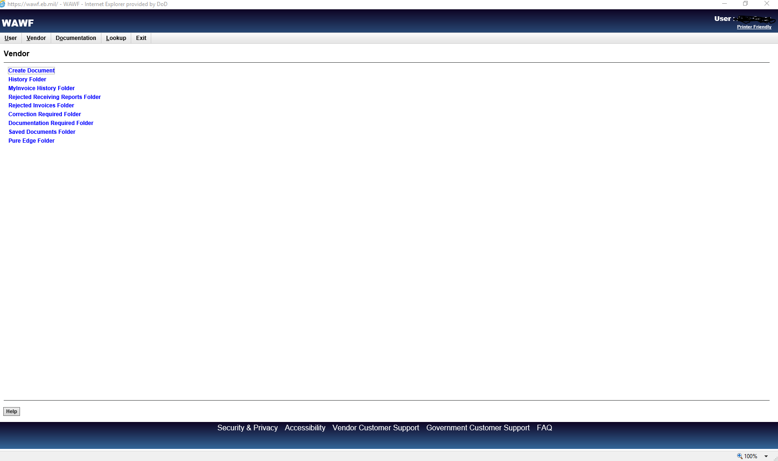

Slide 40
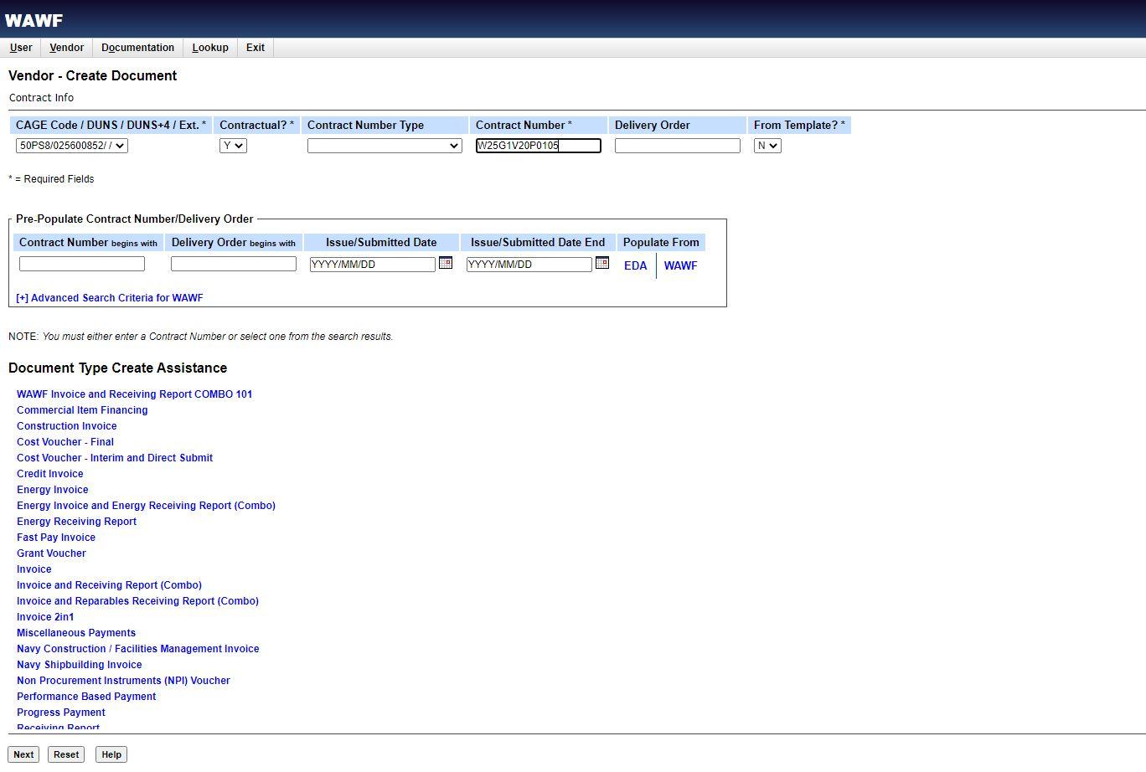
Notes:
If the Cage Code/DUNS field is blank, the vendor is expired in SAM. WAWF will also give an error message. The vendor will not be able to proceed past this screen until their SAM account has been reactivated.

Slide 41
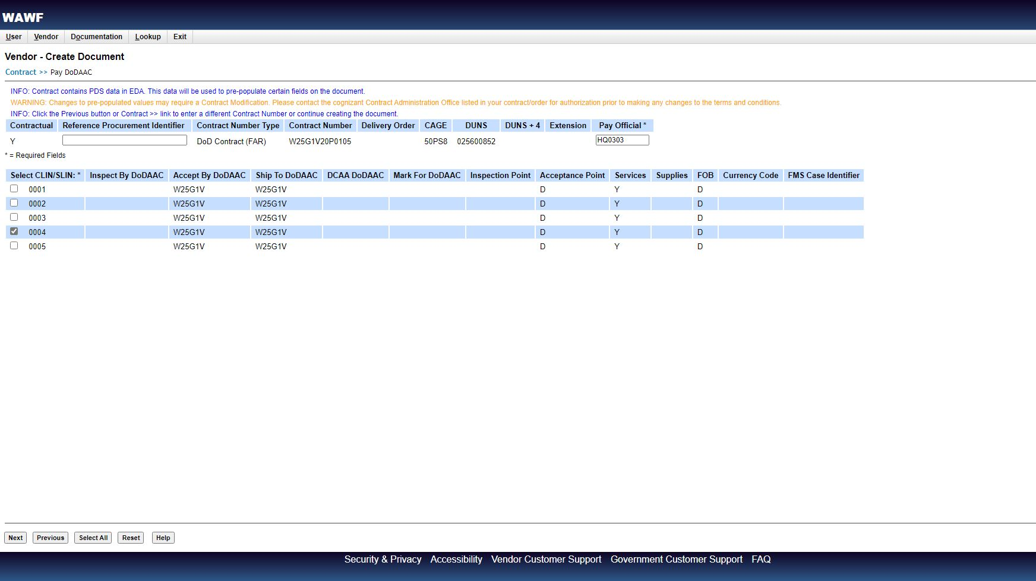
Notes:
CLINs will appear on this screen. Users should check applicable CLINs so that information will populate in the Line Item Tab under “Line Item Details”.

Slide 42
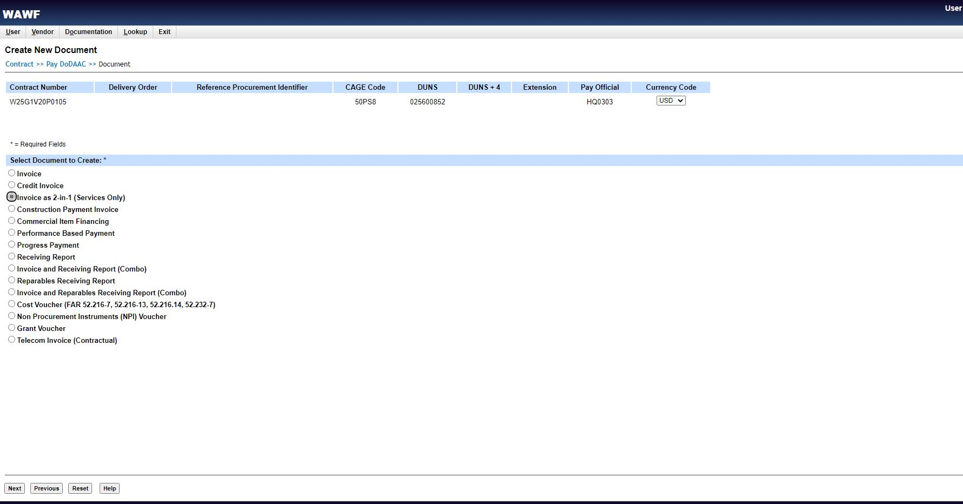
Notes:
Even though WAWF “recommends” documents, it is essential you check paragraph (f)(1)(ii) for DFARS 252.232-7006 for the document type.

Slide 43
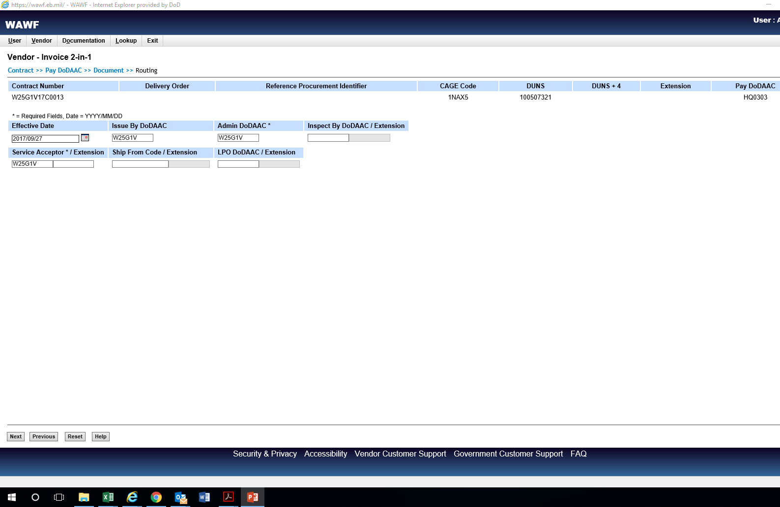
Notes:
These fields are populated from the Routing Data Table in the Wide Area Workflow Payments Instructions clause.

Slide 44
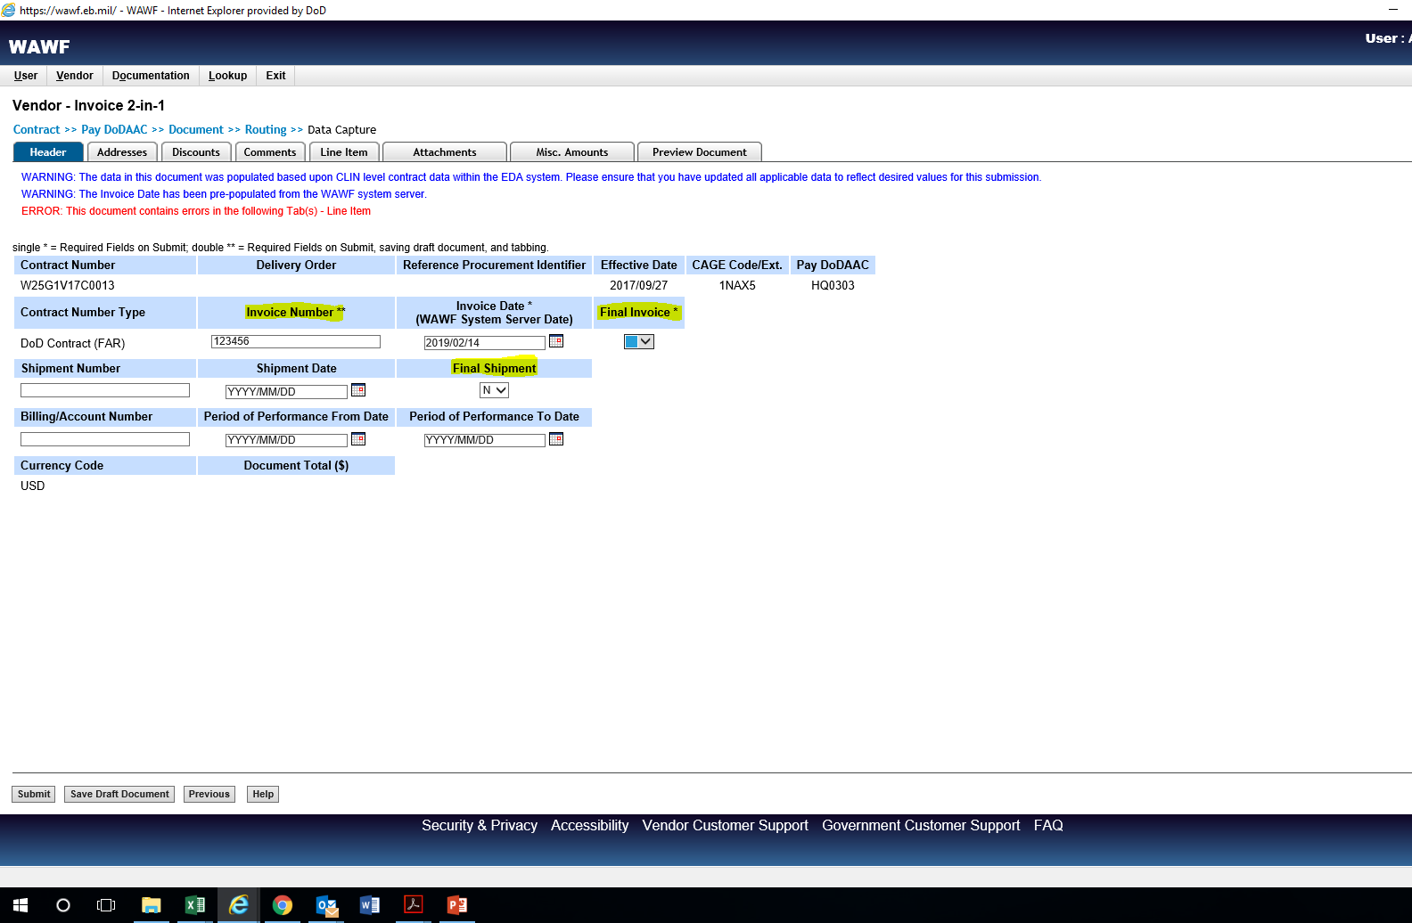
Notes:
Final Shipment is mandatory even for service or construction payment invoices.

Slide 45
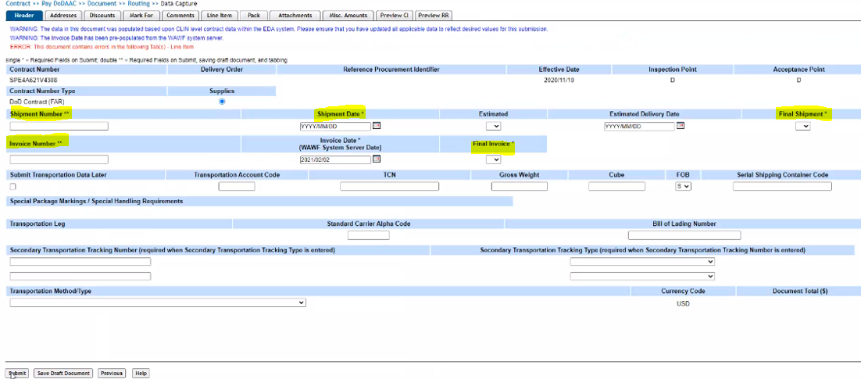
Notes:
This is what the header tab looks like for an Invoice and Receiving Report COMBO.

Slide 46
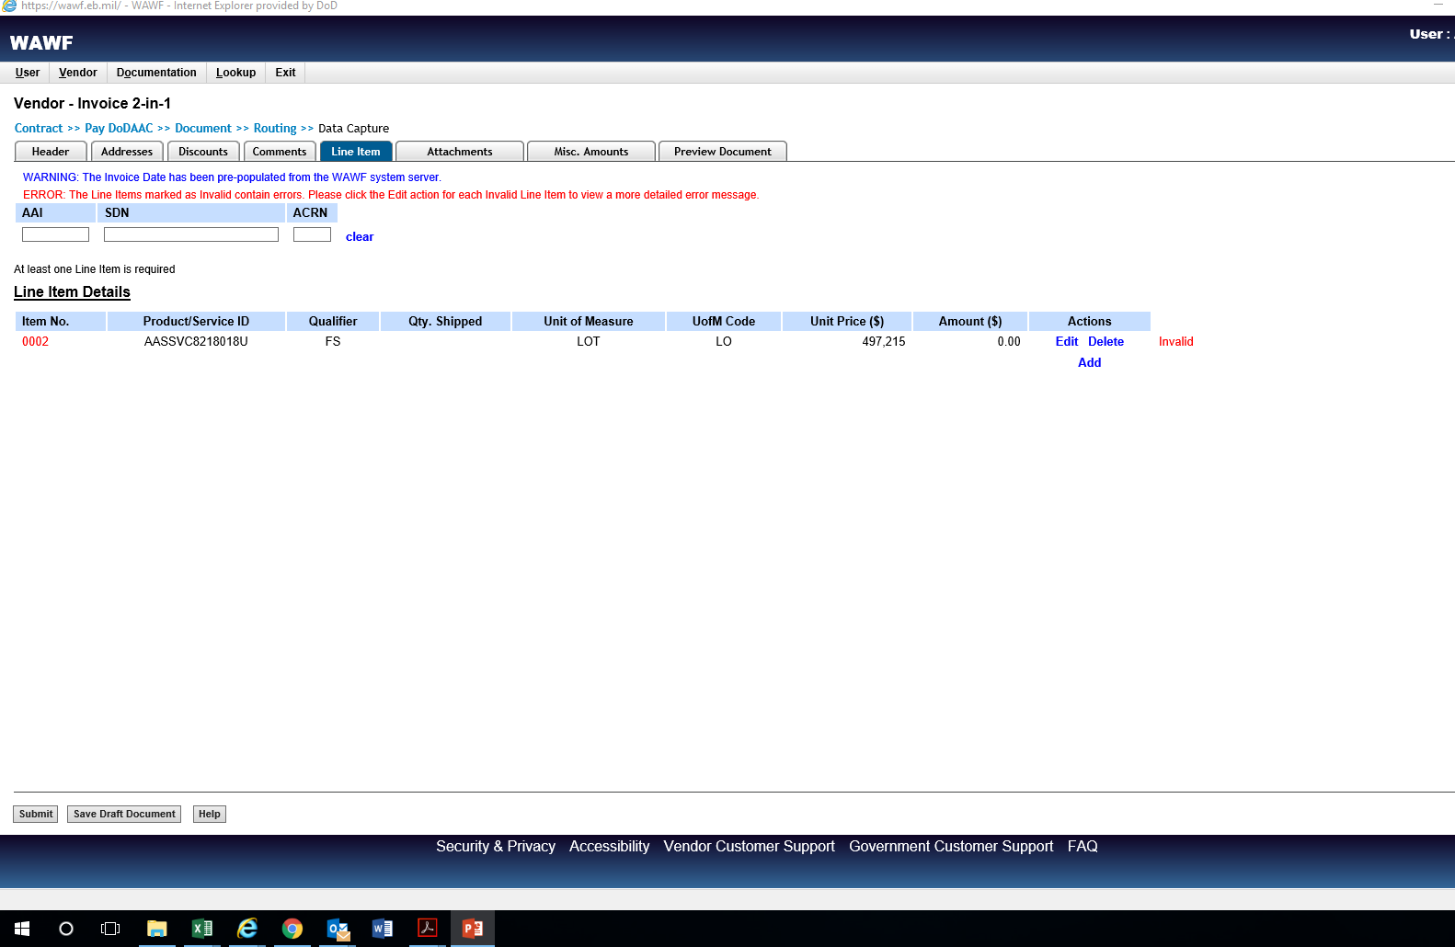
Notes:
The error message on the Line Item tab screen means that information is required in Line Item Details (particularly, the quantity shipped/provided). Users will always see this error message.

Slide 47
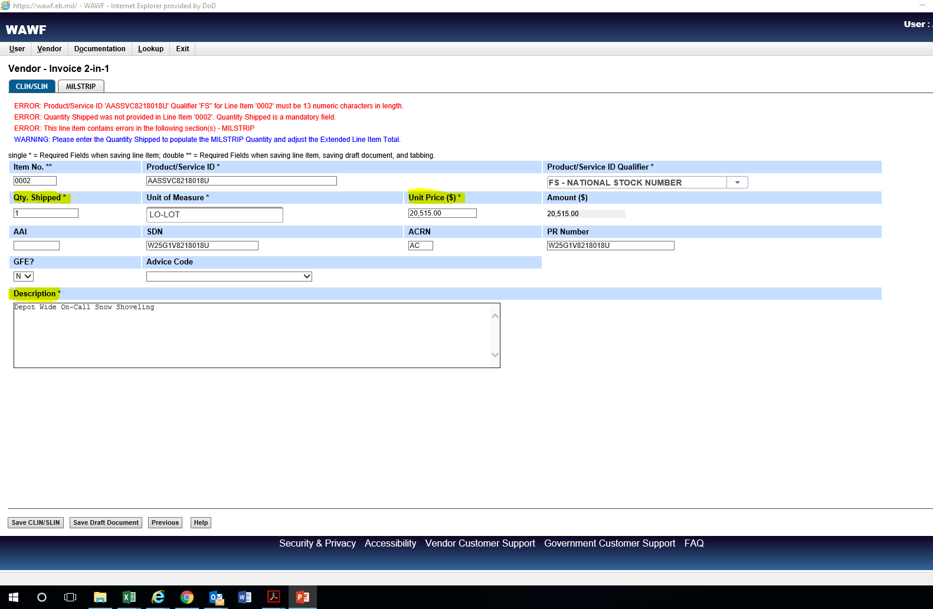
Notes:
Tip: Only complete the mandatory fields (*). Don’t agonize over acronyms, keep it as simple as possible.

Slide 48
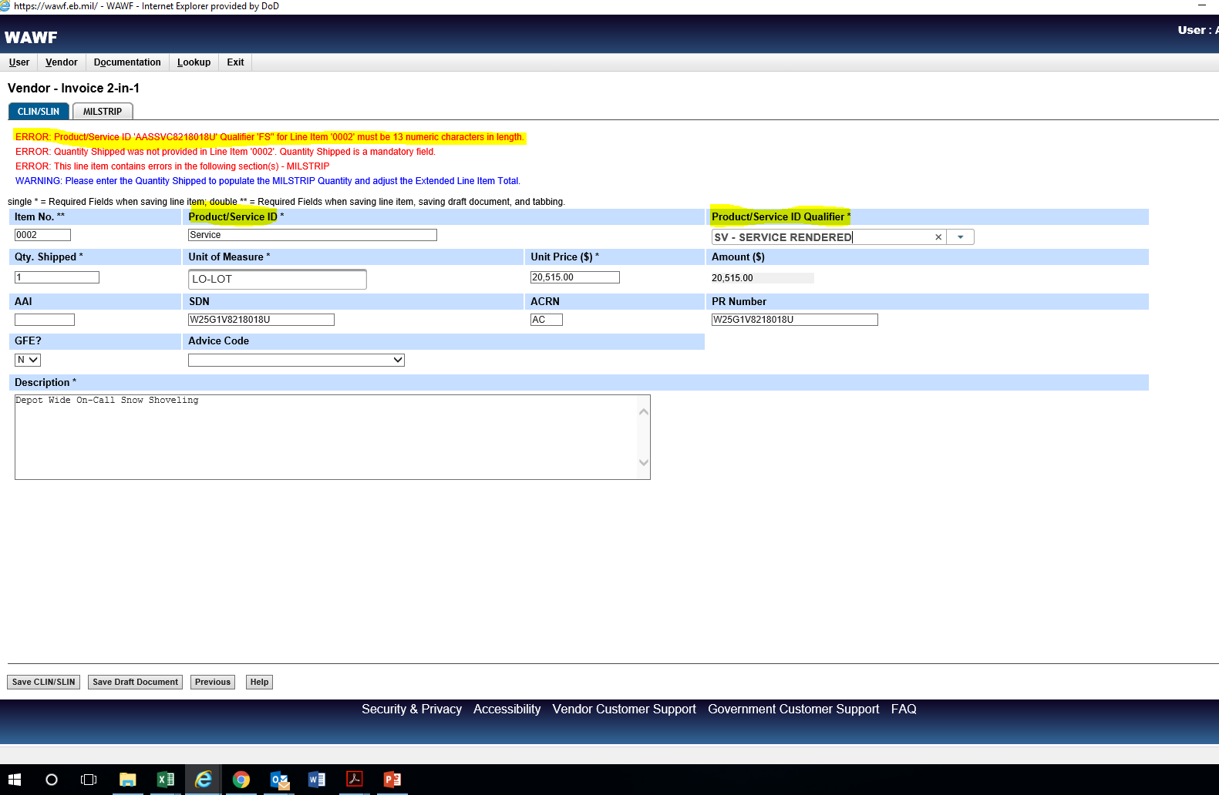
Notes:
In Service 2-IN-1 documents, the Product/Service ID Qualifier defaults to “FS – NATIONAL STOCK NUMBER” and will generate an error message. To correct, either insert an 13-digit NSN is the Product/Service ID or select “SV – SERVICES RENDERED” for the qualifier.

Slide 49
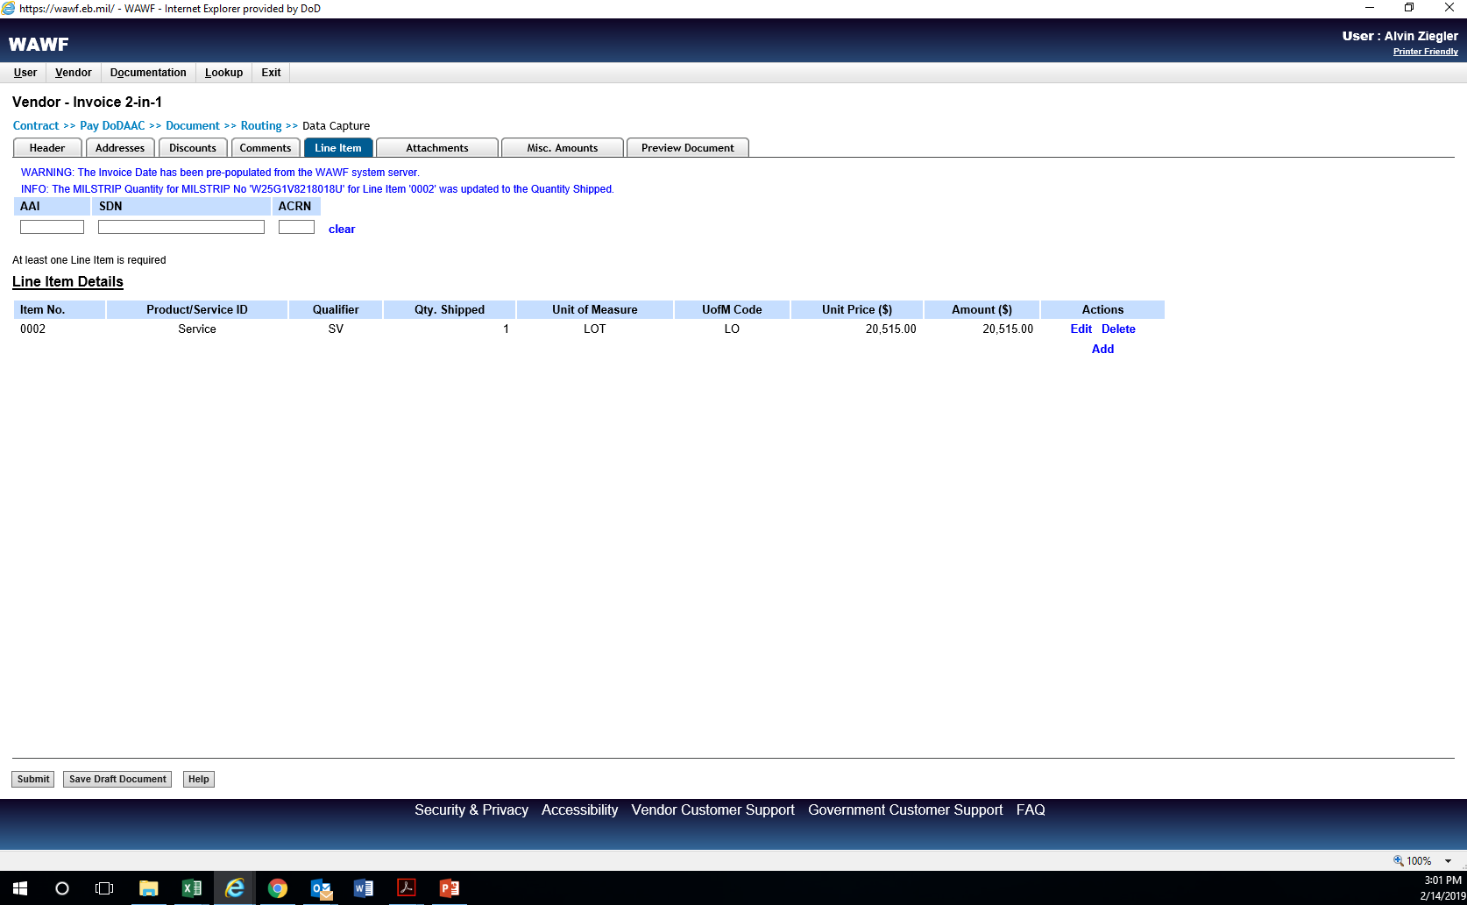

Slide 51
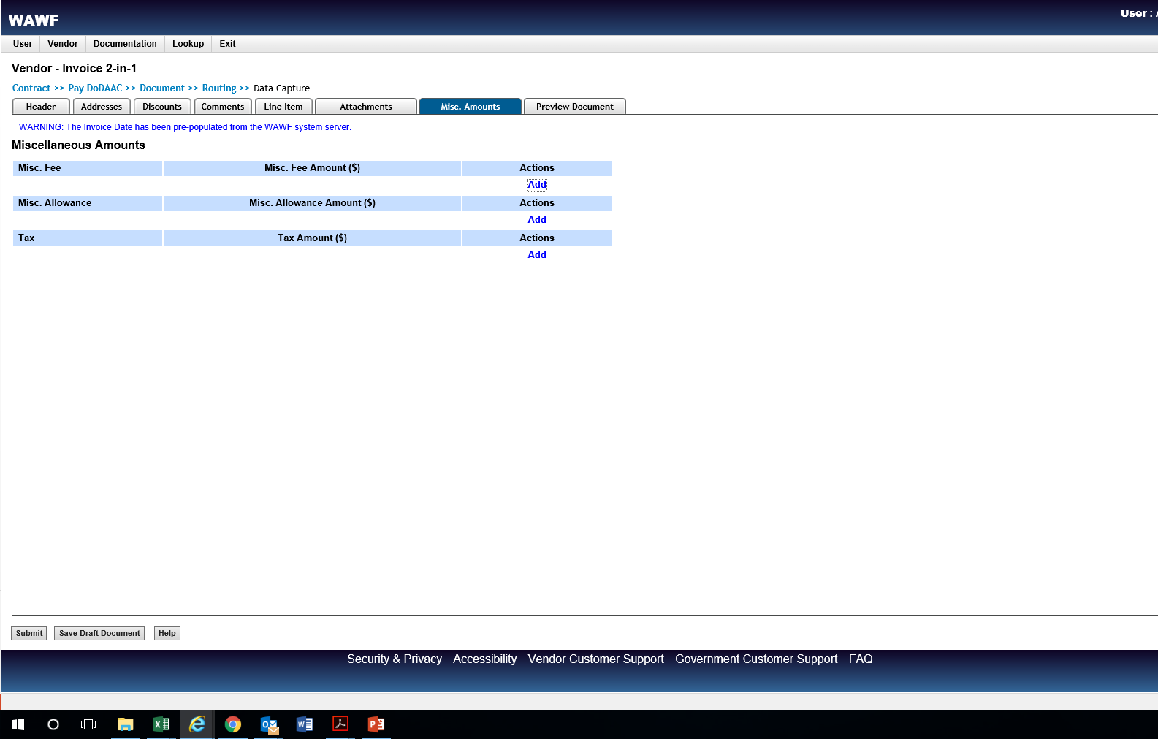

Slide 52
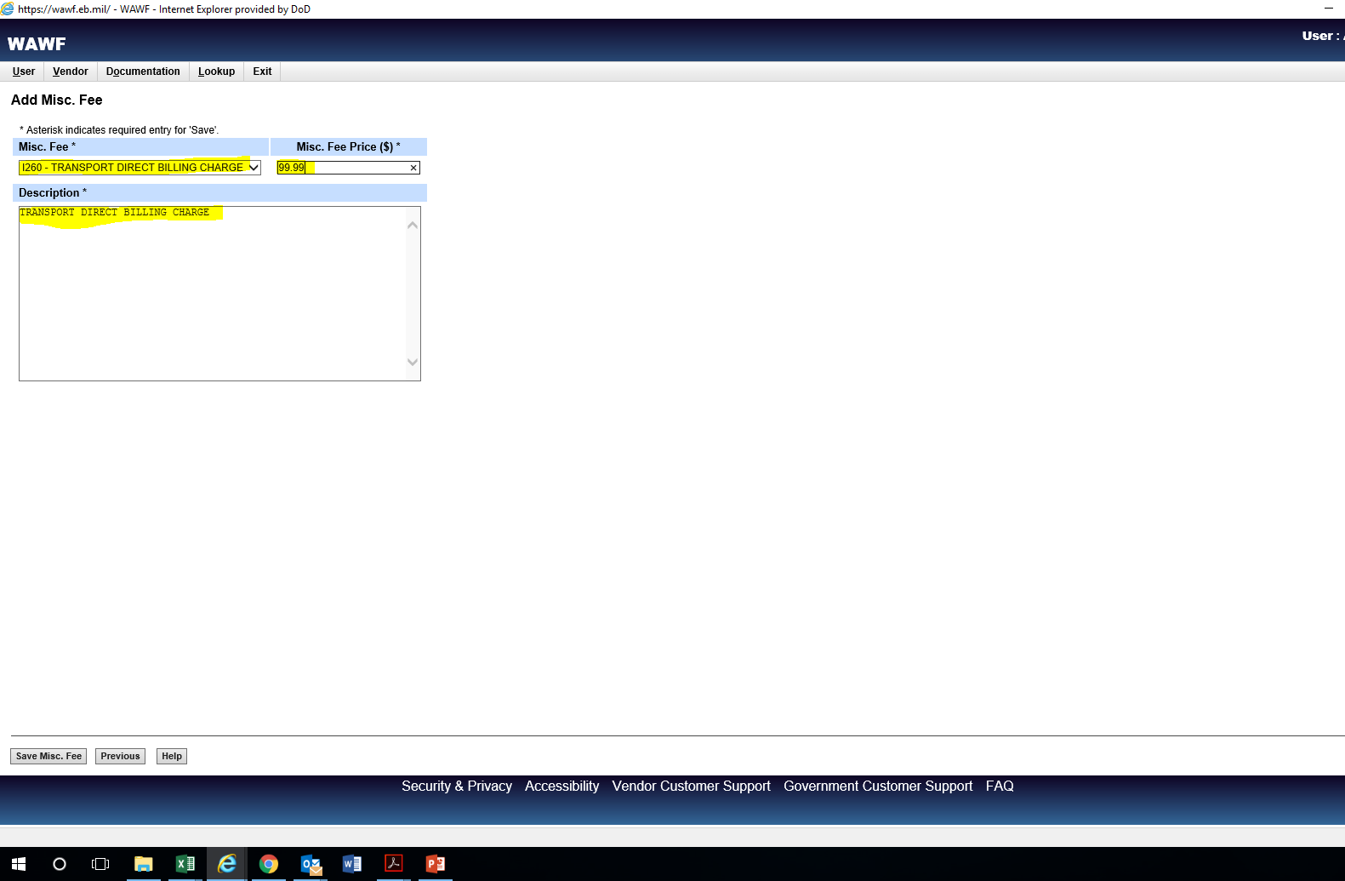
Notes:
Shipping charges over $100 must be substantiated by attaching a copy of the shipping bill. Attaching a rate quote will not suffice.

Slide 53
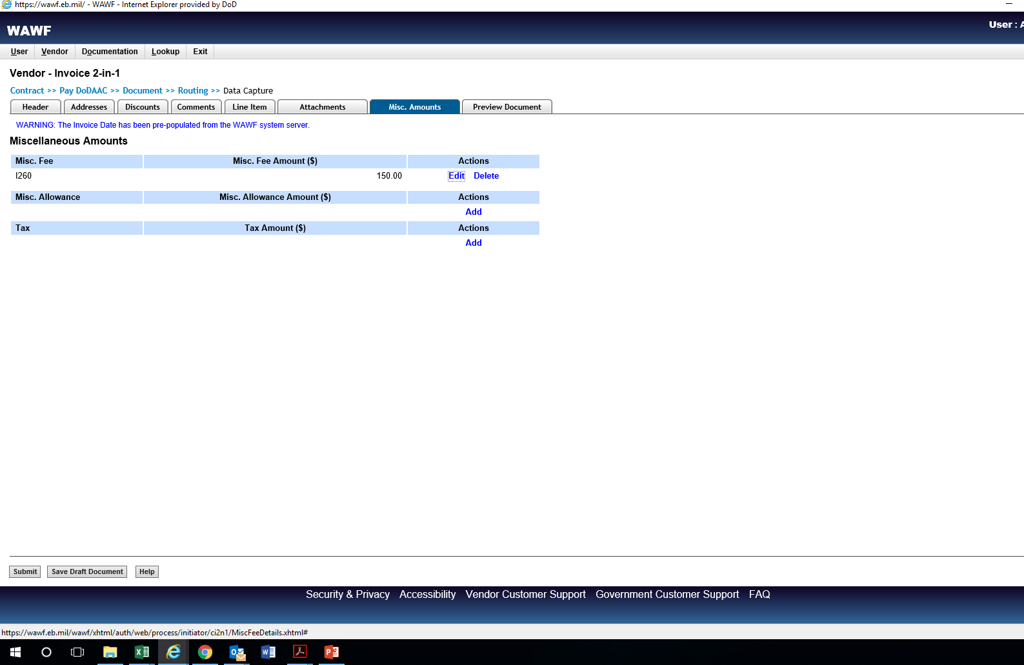
Notes:
Shipping charges over $100 must be substantiated by attaching a copy of the shipping bill. Attaching a rate quote will not suffice.

Slide 54
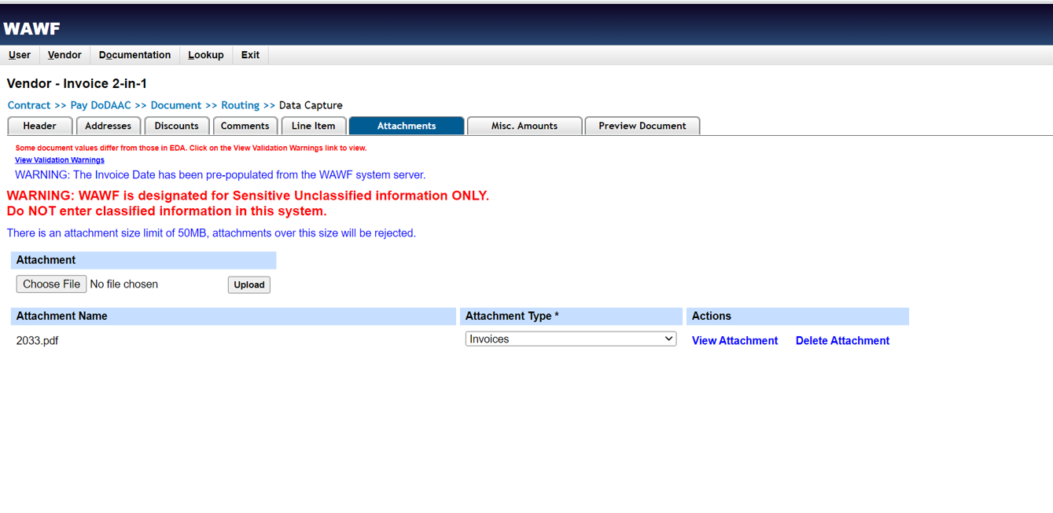
Notes:
Filenames must contain letters or number ONLY. No spaces or special characters.

Slide 55
When uploading documents:
Filenames must contain letters and numbers only. No special characters or spaces are allowed.

Slide 56
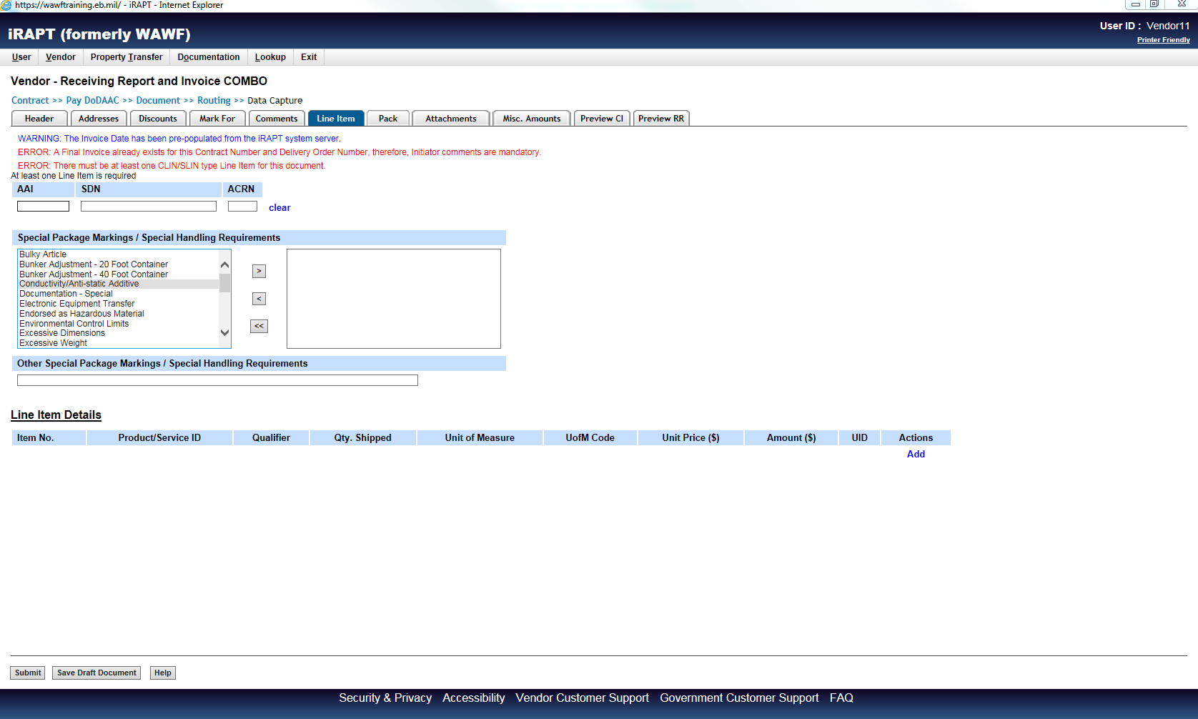
Notes:
This screenshot was added to also show that if no line item data appears, the only option is to add it.

Slide 57
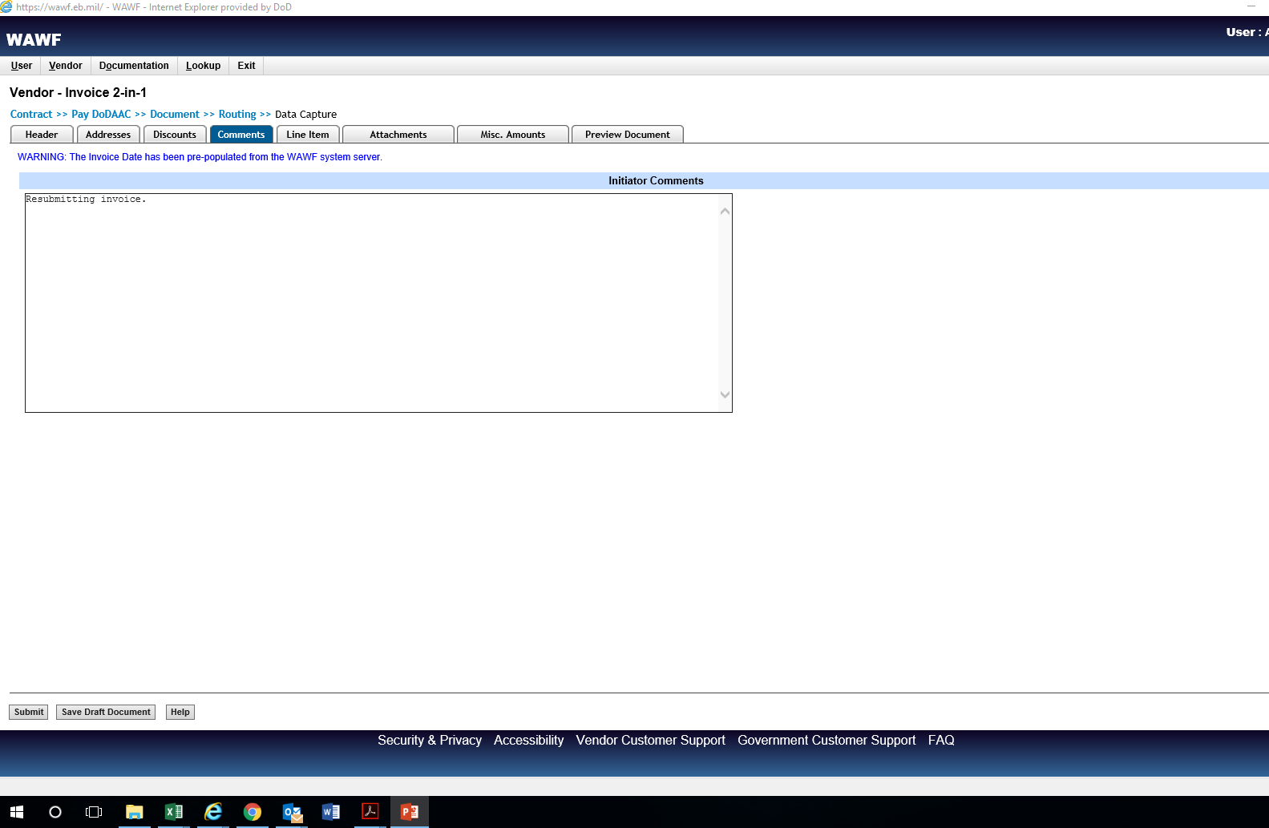
Notes:
Comments are required when a payment request is rejected (“why” was it rejected). Comments are also required in other cases, UID exempt or submitting a “final after final” invoice, as examples.

Slide 58
Comments are required when a payment request is rejected by the Government (why was it rejected).
Comments are also required by the vendor in certain cases, such as when an item is UID exempt or submitting a “final after final” invoice, as examples.

Slide 59
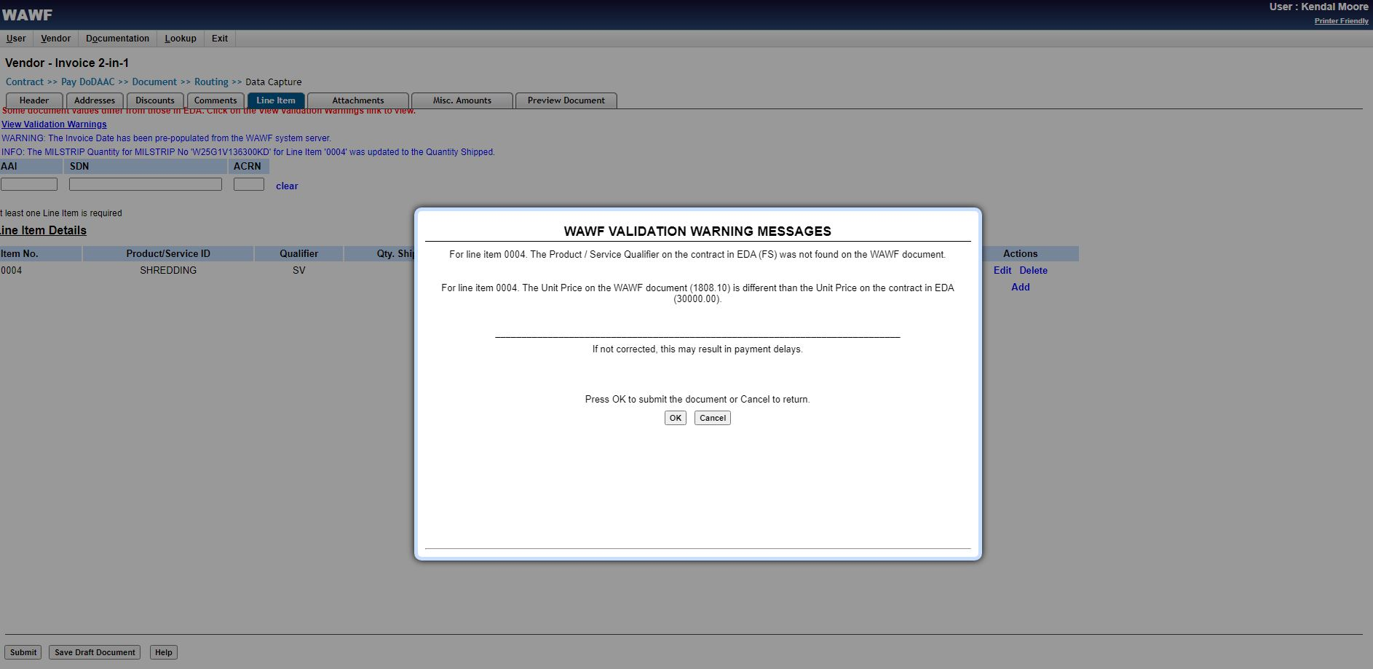
Notes:
Validation Warning Messages are just that – warnings. They are not errors. It simply means that values were changed in the payment request and differ from the values in the contract. At this point, the vendor can make a final review of the amount requested and click OK to submit.

Slide 60
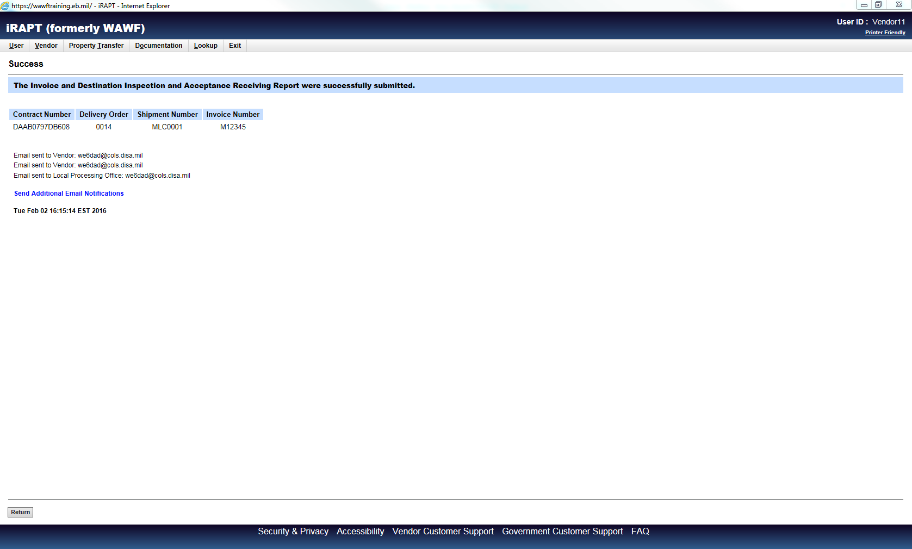

Slide 61
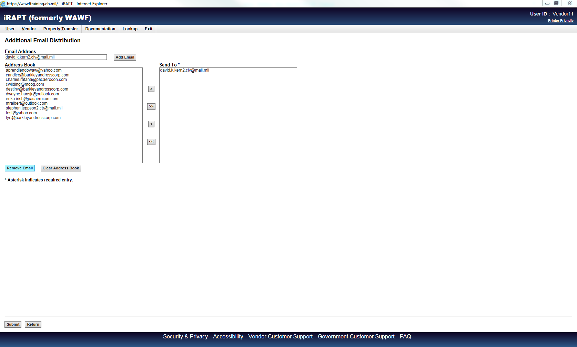

Slide 62
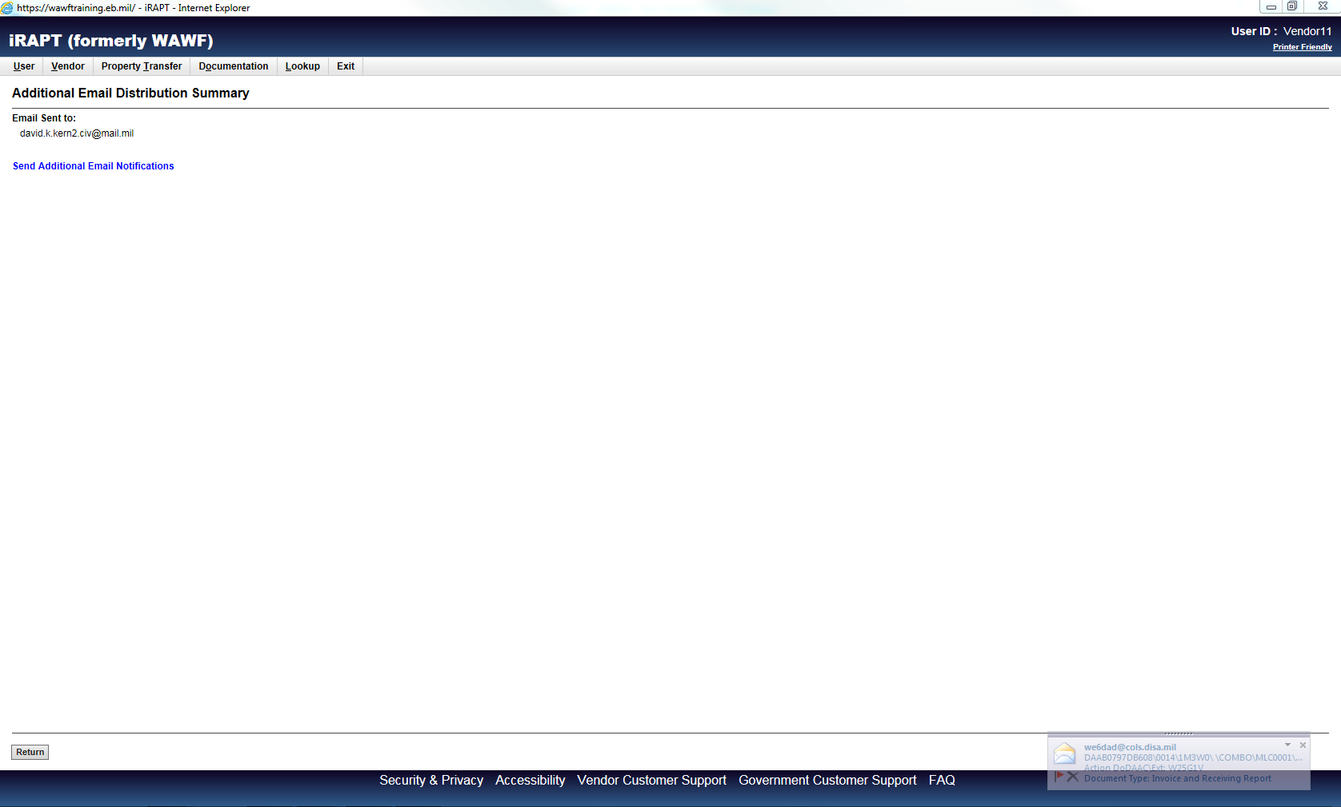

Slide 63
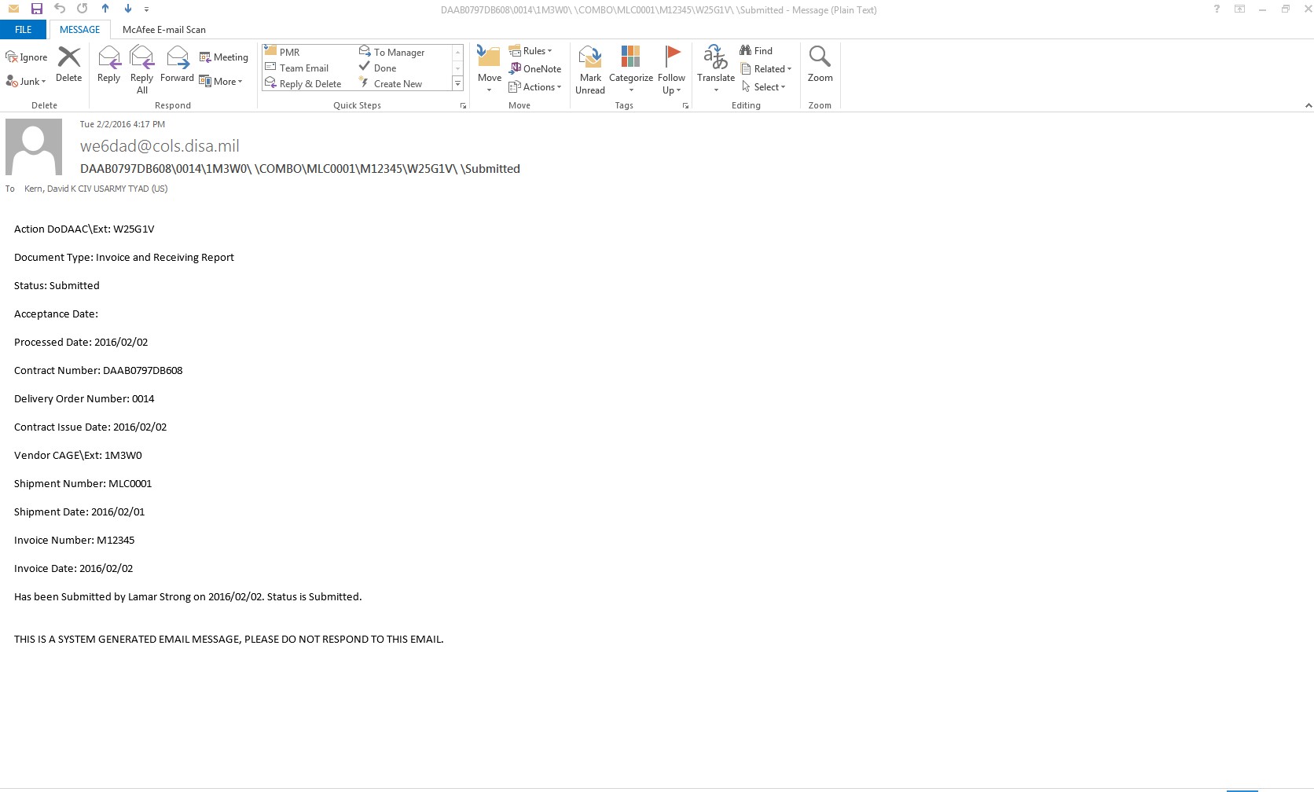

Slide 64
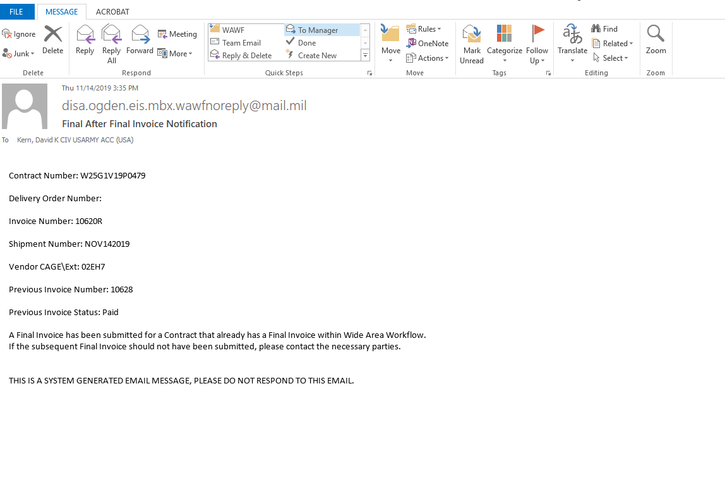
Notes:
This is the email notification generated to the group administrator of a “final after final” invoice submission.

Slide 66


Slide 67


Slide 68
Payment requests can suspend if they are incorrect OR correct. Some examples:
Obvious mistakes (wrong/mistyped CLIN, amount requested exceeds amount available)
Vendor expired in CEFT (SAM)
If shipping charges are added (FAR 52.247-29)
Variations in quantities (FAR 52.211-16)
If the latter two are authorized by contract clause, DFAS will regenerate and the status will change to PROCESSED in WAWF.
Notes:
DFAS will not wire funds to an account if the vendor is expired in SAM.

Slide 69

Construction and Facilities Management Invoice

Slide 70

Construction and Facilities Management Invoice

Slide 71


Slide 72
A word about One Time Password (OTP):
OTPs are required for every Construction Payment Invoice because they require contractor certification before being submitted.
OTPs are required for new registrations.
OTP infrastructure is not always reliable, meaning it may not work after you type it and try to submit.

Slide 73


Slide 74


Slide 75
QUESTIONS?

Slide 77


Slide 78


Slide 79


Slide 80


Slide 81


Slide 82
A note about payment terms (FAR 32.904):
For supply and service contracts, the due date for making a payment:
  The 30th day after the designated billing office receives a proper invoice from the contractor, or
  The 30th day after Government acceptance of supplies delivered or services performed, whichever date is later.
For construction contracts, the due date for making a payment:
  For interim (progress) payments, 14 days after the designated billing office receives a proper payment request.
  Final payment is due by the 30th day, conditions are the same as above.
Final payment is made when the contract is “physically complete” meaning all supplies and services have been delivered and accepted by the Government.

Slide 83


Slide 84



Slide 85


Slide 86


Slide 87


Slide 88


Slide 89


Slide 90

Changing the WAWF POC

Slide 91

Changing the WAWF POC

Slide 92

Changing the WAWF POC

Slide 93

Changing the WAWF POC

Slide 94

Changing the WAWF POC

Slide 95

Changing the WAWF POC

Slide 96

Changing the WAWF POC

Slide 97
QUESTIONS?

Slide 98
Wide Area Workflow (WAWF)
David Kern
Small Business Professional
Tobyhanna Army Depot
570.615.8733
david.k.kern2.civ@army.mil
THANK YOU!!!

